Slide 1
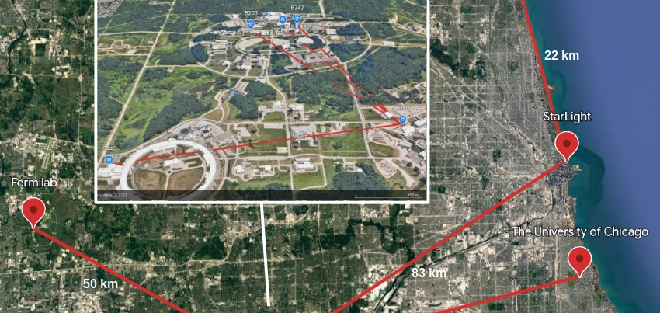
InterQnet: A systems Approach to realize a Scalable Quantum Network
Hacktheon Joint conference 2024
erhtjhtyhy
Raj Kettimuthu
Senior Scientist and Group Leader
Data Science and Learning Division
Argonne National Laboratory
June 19, 2024

Slide 2
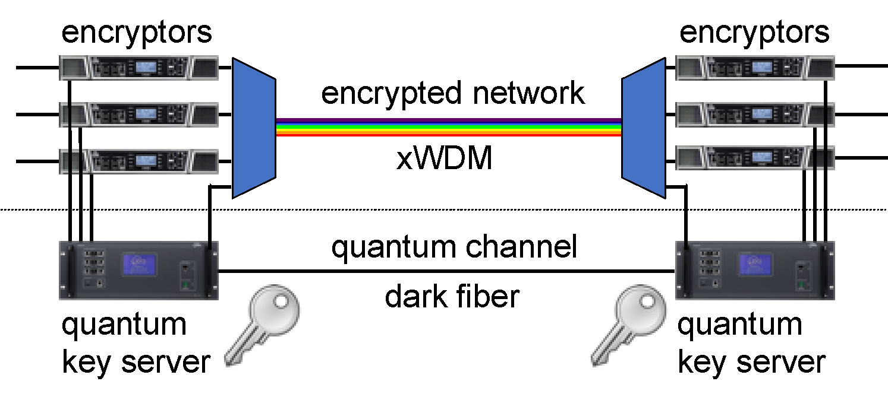
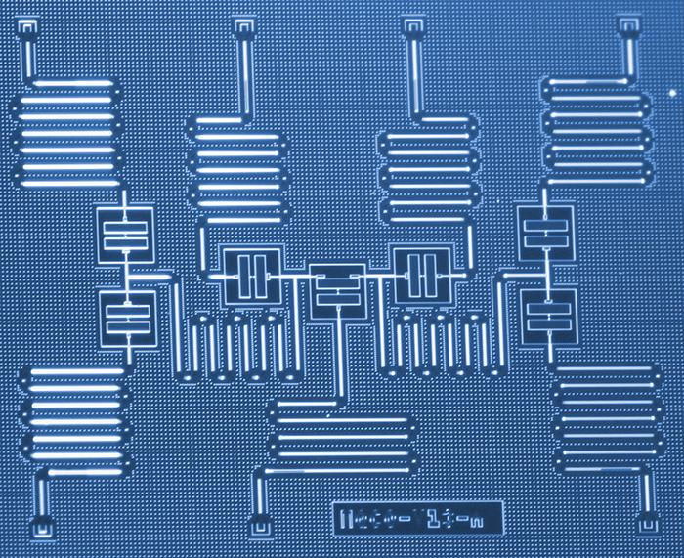
Quantum Communications
What is it all about?
Started with the goal of making classical communication more secure by using the laws of physics (quantum key distribution: QKD)
Now its aim is to communicate quantum information (qubits) between distant entities
  Distributed quantum computing
  Distributed quantum sensing
To achieve this ultimate goal, we need quantum networks capable of efficiently transmitting qubits
Quantum key distribution
Distributed quantum computing

Slide 3


Qubit
Classical bit: | Qubit: | Multi-qubit systems:
|0⟩
𝛼|0⟩ + β|1⟩
2 qubits: 𝛼|00⟩ + β|01⟩ + 𝛾|10⟩ + 𝛿|11⟩
3 qubits: 𝛼|000⟩ + β|001⟩ + 𝛾|010⟩ + 𝛿|011⟩ + 𝜀|100⟩ + 𝜁|101⟩ + 𝜂|110⟩ + 𝜃|111⟩
|1⟩
Basic unit of information in quantum computing that utilizes the phenomenon of superposition to achieve a linear combination of two states.
Matter qubits (e.g., atomic energy levels, electron spins, etc.)
Flying qubits (e.g., photons)
Notes:
qubit — the basic unit of quantum information and it is a 2-dimensional complex vector. The 2-dimensional vectors can be physically represented by quantum mechanical systems, such as atomic energy levels, spin, polarization, and many more. The state of a qubit is the particular vector value the qubit has.

Slide 4
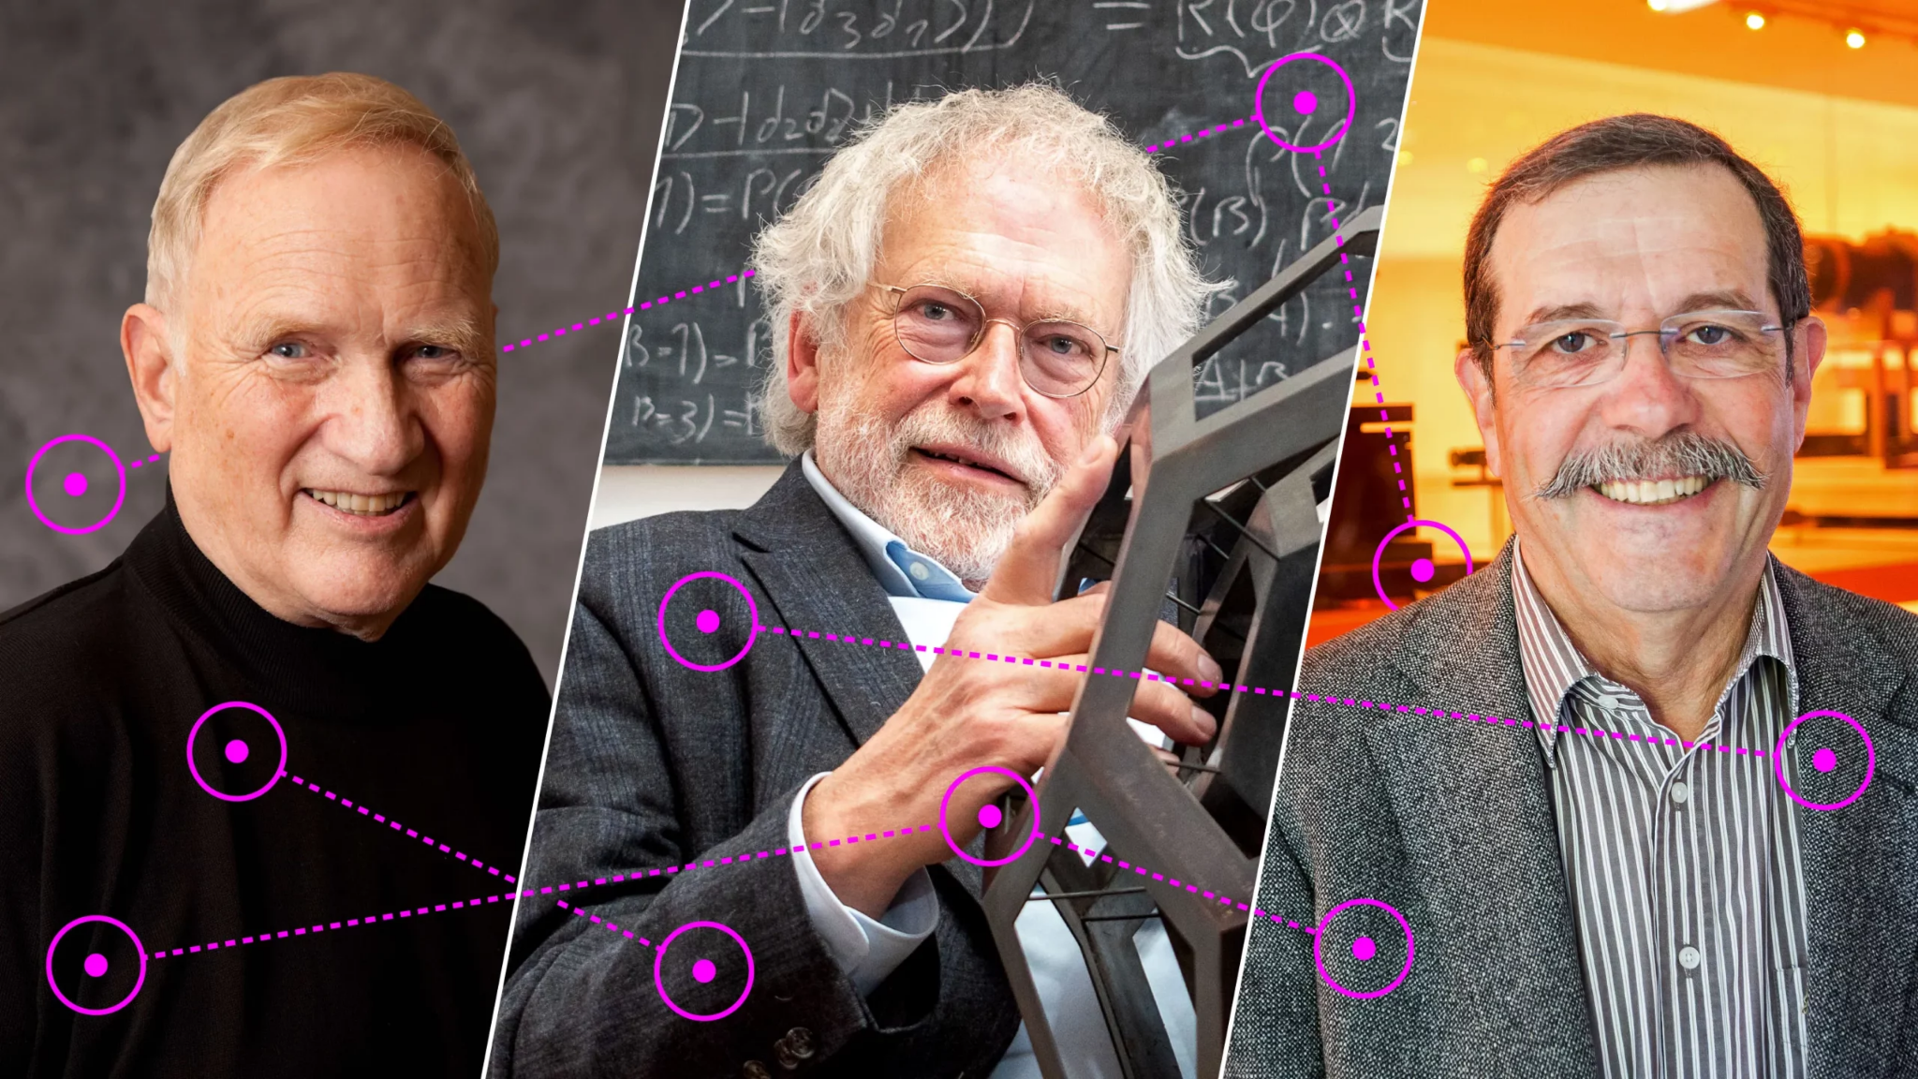
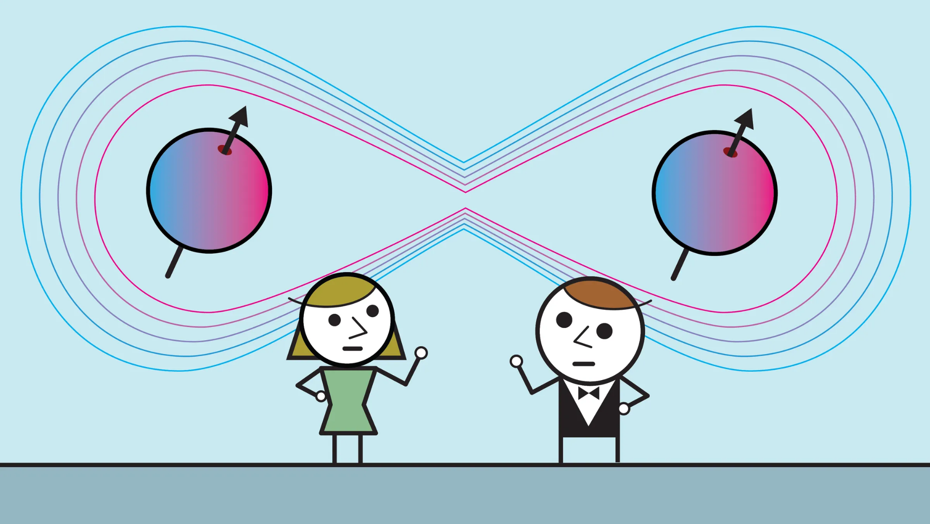
Quantum Entanglement
Foundation for near-term quantum networks
Phenomenon in which two or more particles are connected in such a way that they cannot be described independently. Moreover, they will remain connected despite distance.
John Clauser, Anton Zeilinger and Alain Aspect, winners of the Nobel prize in Physics for their work in quantum entanglement
Notes:
Entanglement is a fundamental concept in quantum information theory, considered by many to be a quintessential characteristic that distinguishes quantum systems from their classical counterparts.

Slide 5
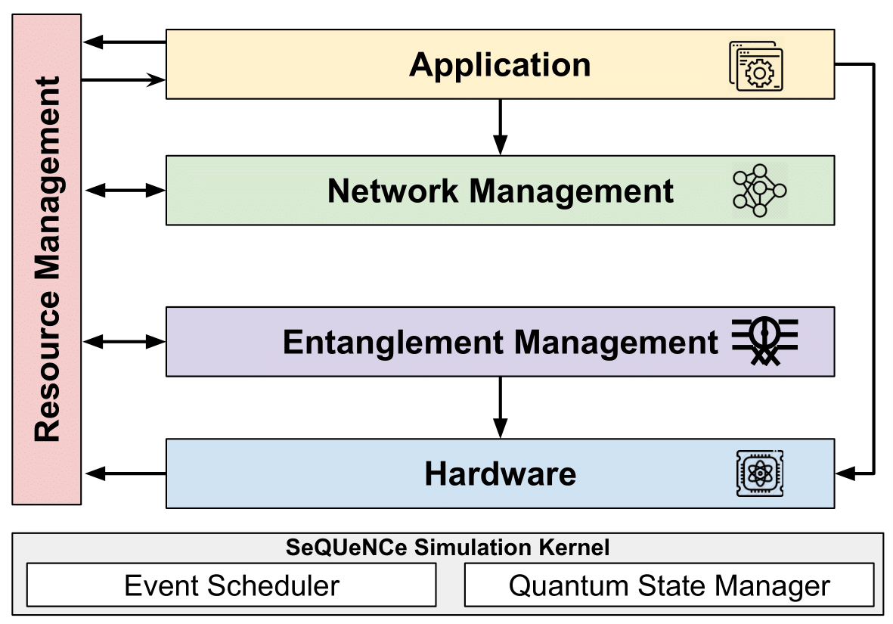
SeQUeNCe: Simulator of Quantum Network Communication
Modularized discrete event simulator with a clear separation of functionality
Simulates quantum communication at photon-level with picosecond accuracy
Allows simulations with different parameters, protocols, topologies, and network architectures
Hardware models of single-atom memories, entanglement generation, swapping, and purification protocols
Notes:
SeQUeNCe is an open source, discrete-event simulator for quantum networks. It uses the properties and functionalities of each element in the quantum network such as photon, QM, EG, QNo, QCh, and CC to model and simulate them. It uses a modular framework with clear separation of functionality. These modules can be used as-is to test network parameters and topologies or can be edited to add and test additional functionality. RM and NM modules use classical control messages to manage allocation of network resources. EM and HW modules encompass protocols and hardware operations that act on qubits that are located in quantum memories or in photons at telecommunication wavelengths in optical network links.

Slide 6
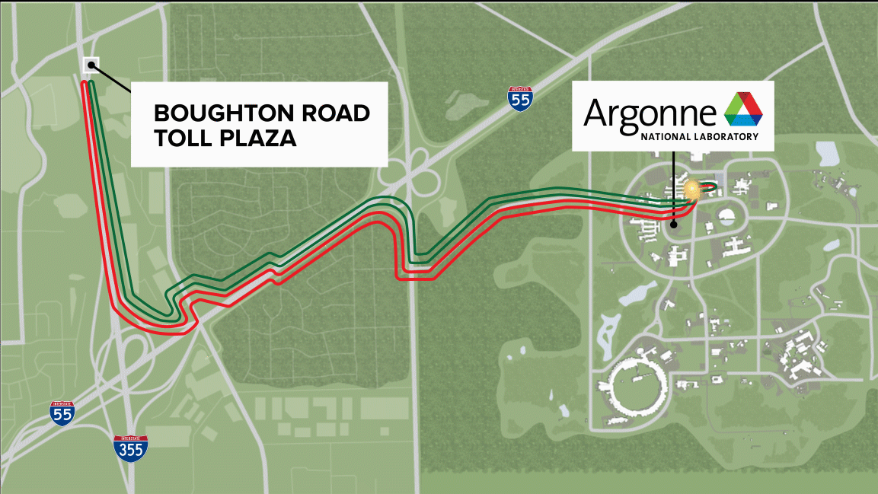
Argonne Quantum Link
Awschalom, Dibos, Heremans et. al

Slide 7
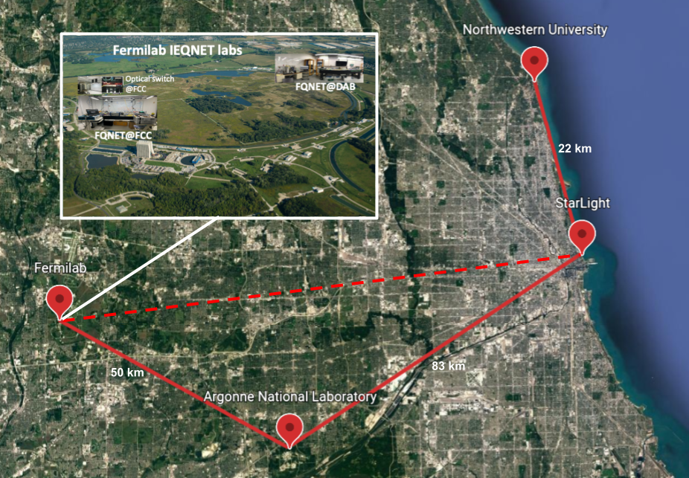
The IEQNET Project
Illinois Express Quantum Network

Slide 8
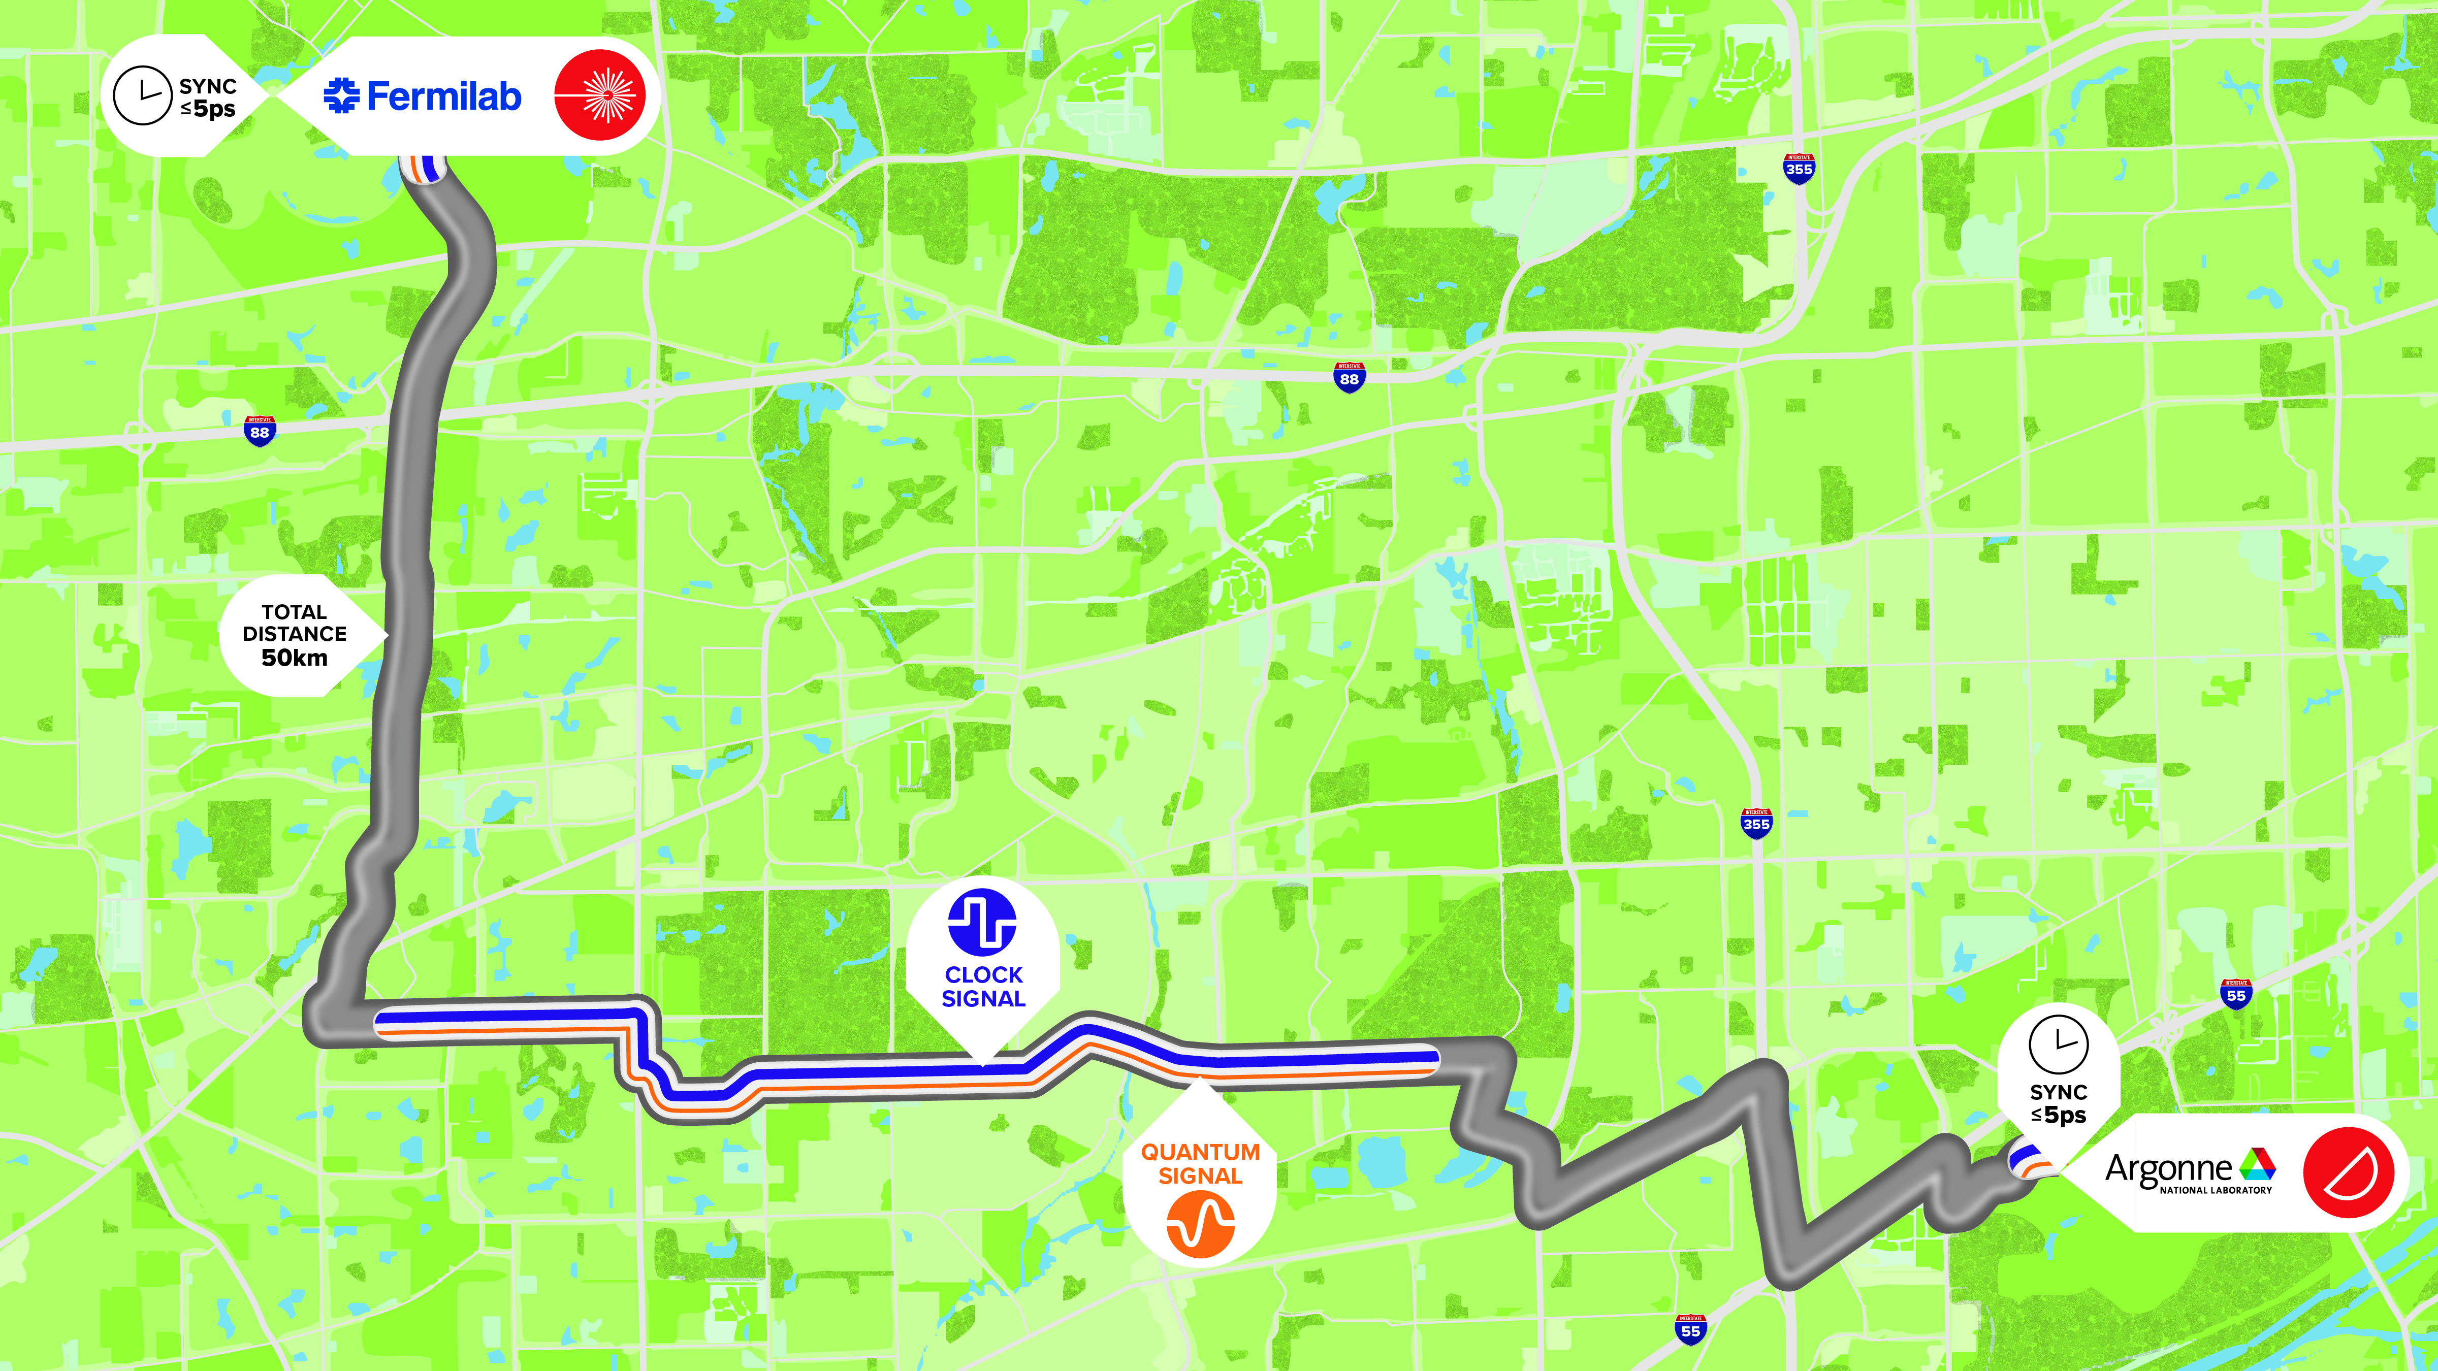
Coexistence of Qubits with Clock Signals
Between Fermilab and Argonne

Slide 9
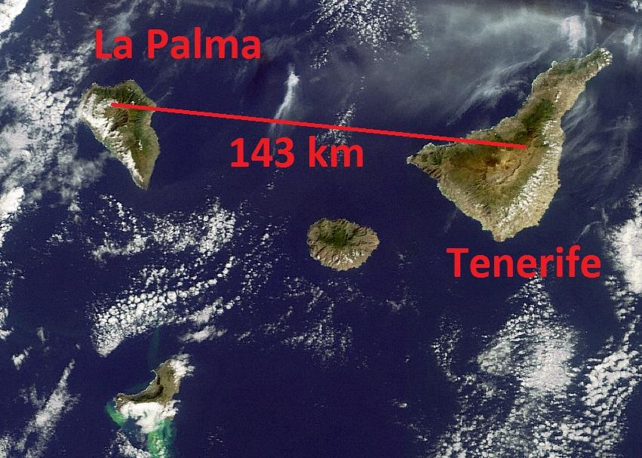
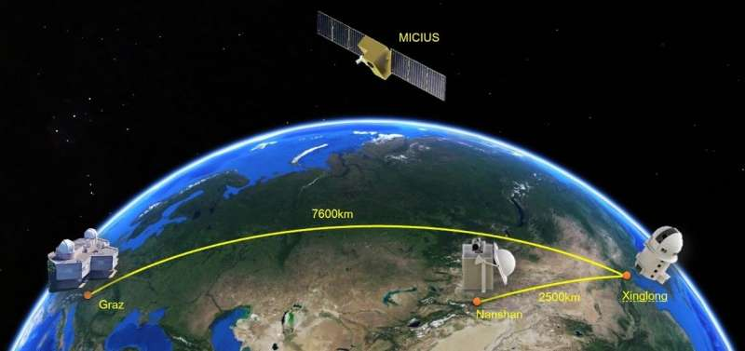
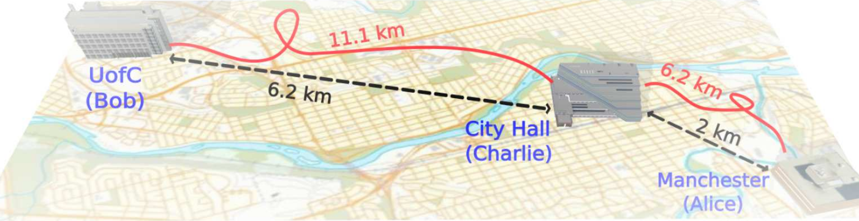
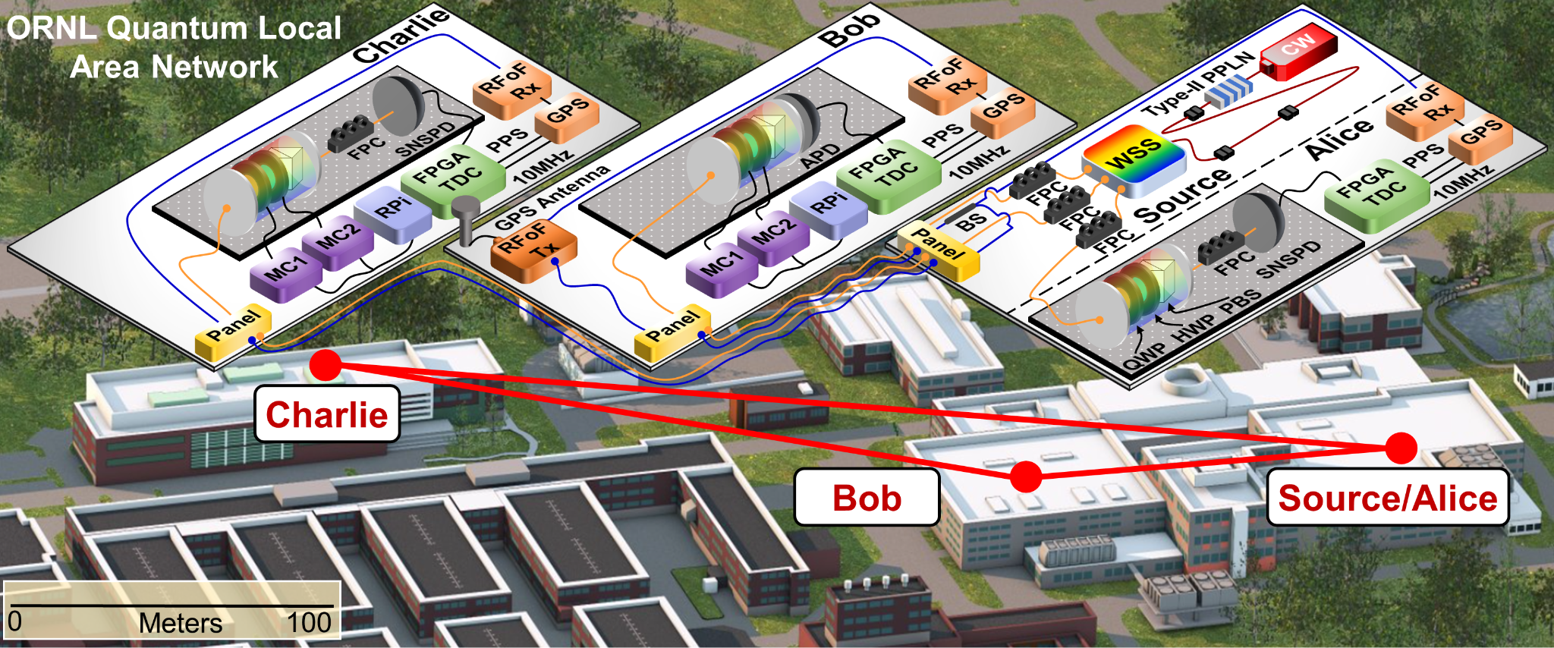
Quantum network demonstrators
Most quantum networking demonstrators focus on point-to-point or linear topologies
There is great need to develop architectures for fully dynamic and automated quantum networks using existing technologies to demonstrate multi-user, multi-node capabilities in metropolitan scales that go beyond linear topologies
Notes:
Caveat: IEQNET started in 2019, so the proposal was written in 2018.

Slide 10
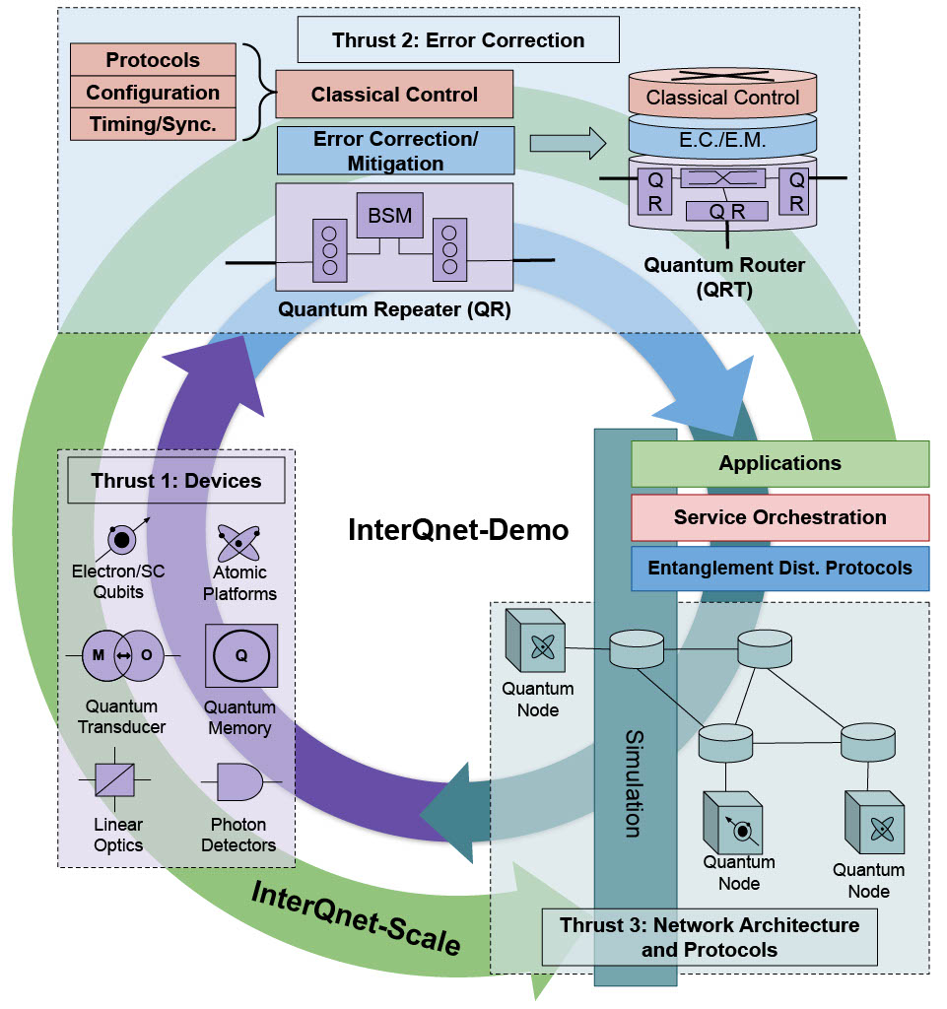
InterQnet: A Heterogeneous Full-Stack Approach to Co-designing Scalable Quantum Networks
InterQnet-Achieve
DOE ASCR Scientiﬁc Enablers of Scalable Quantum Communications

Slide 11
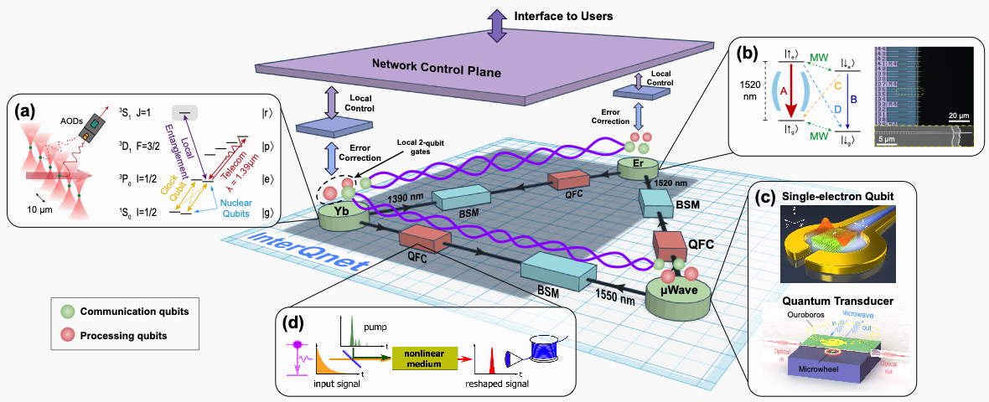
InterQnet-Achieve
Notes:
The goal is to enable quantum communications between two heterogeneous quantum platforms through a third type of platform operating as a repeater node. It requires significant improvement in device capabilities.

Slide 12
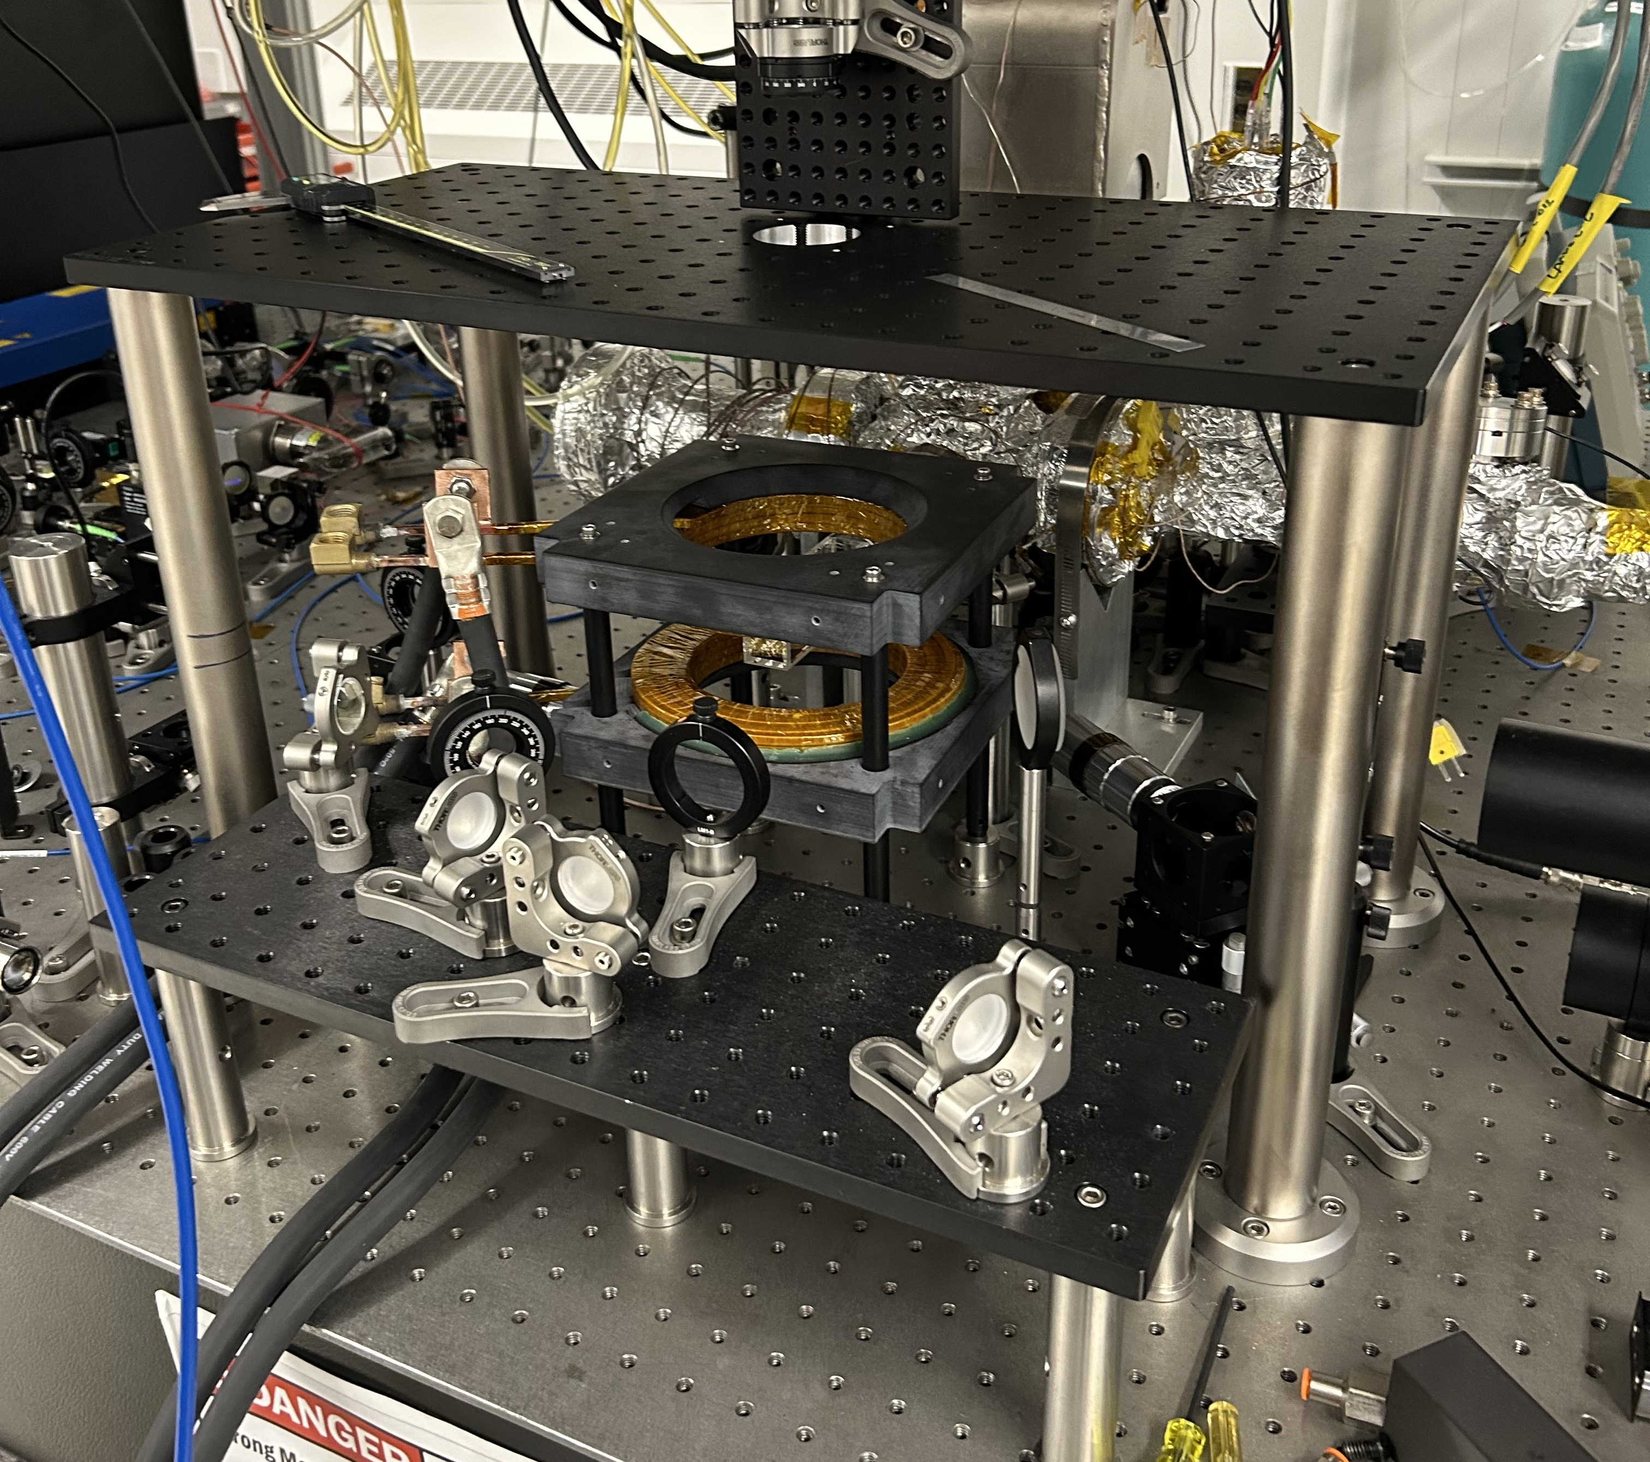
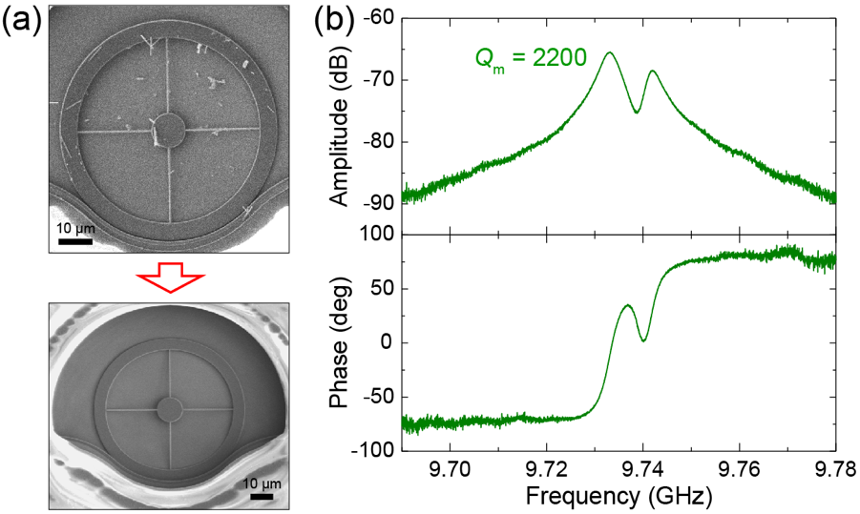
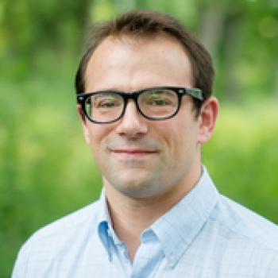
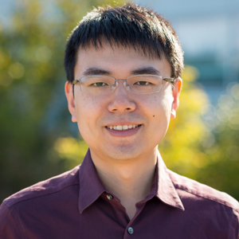

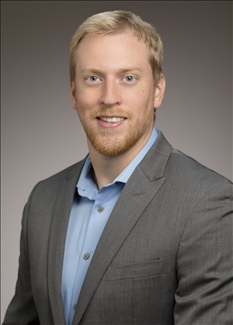

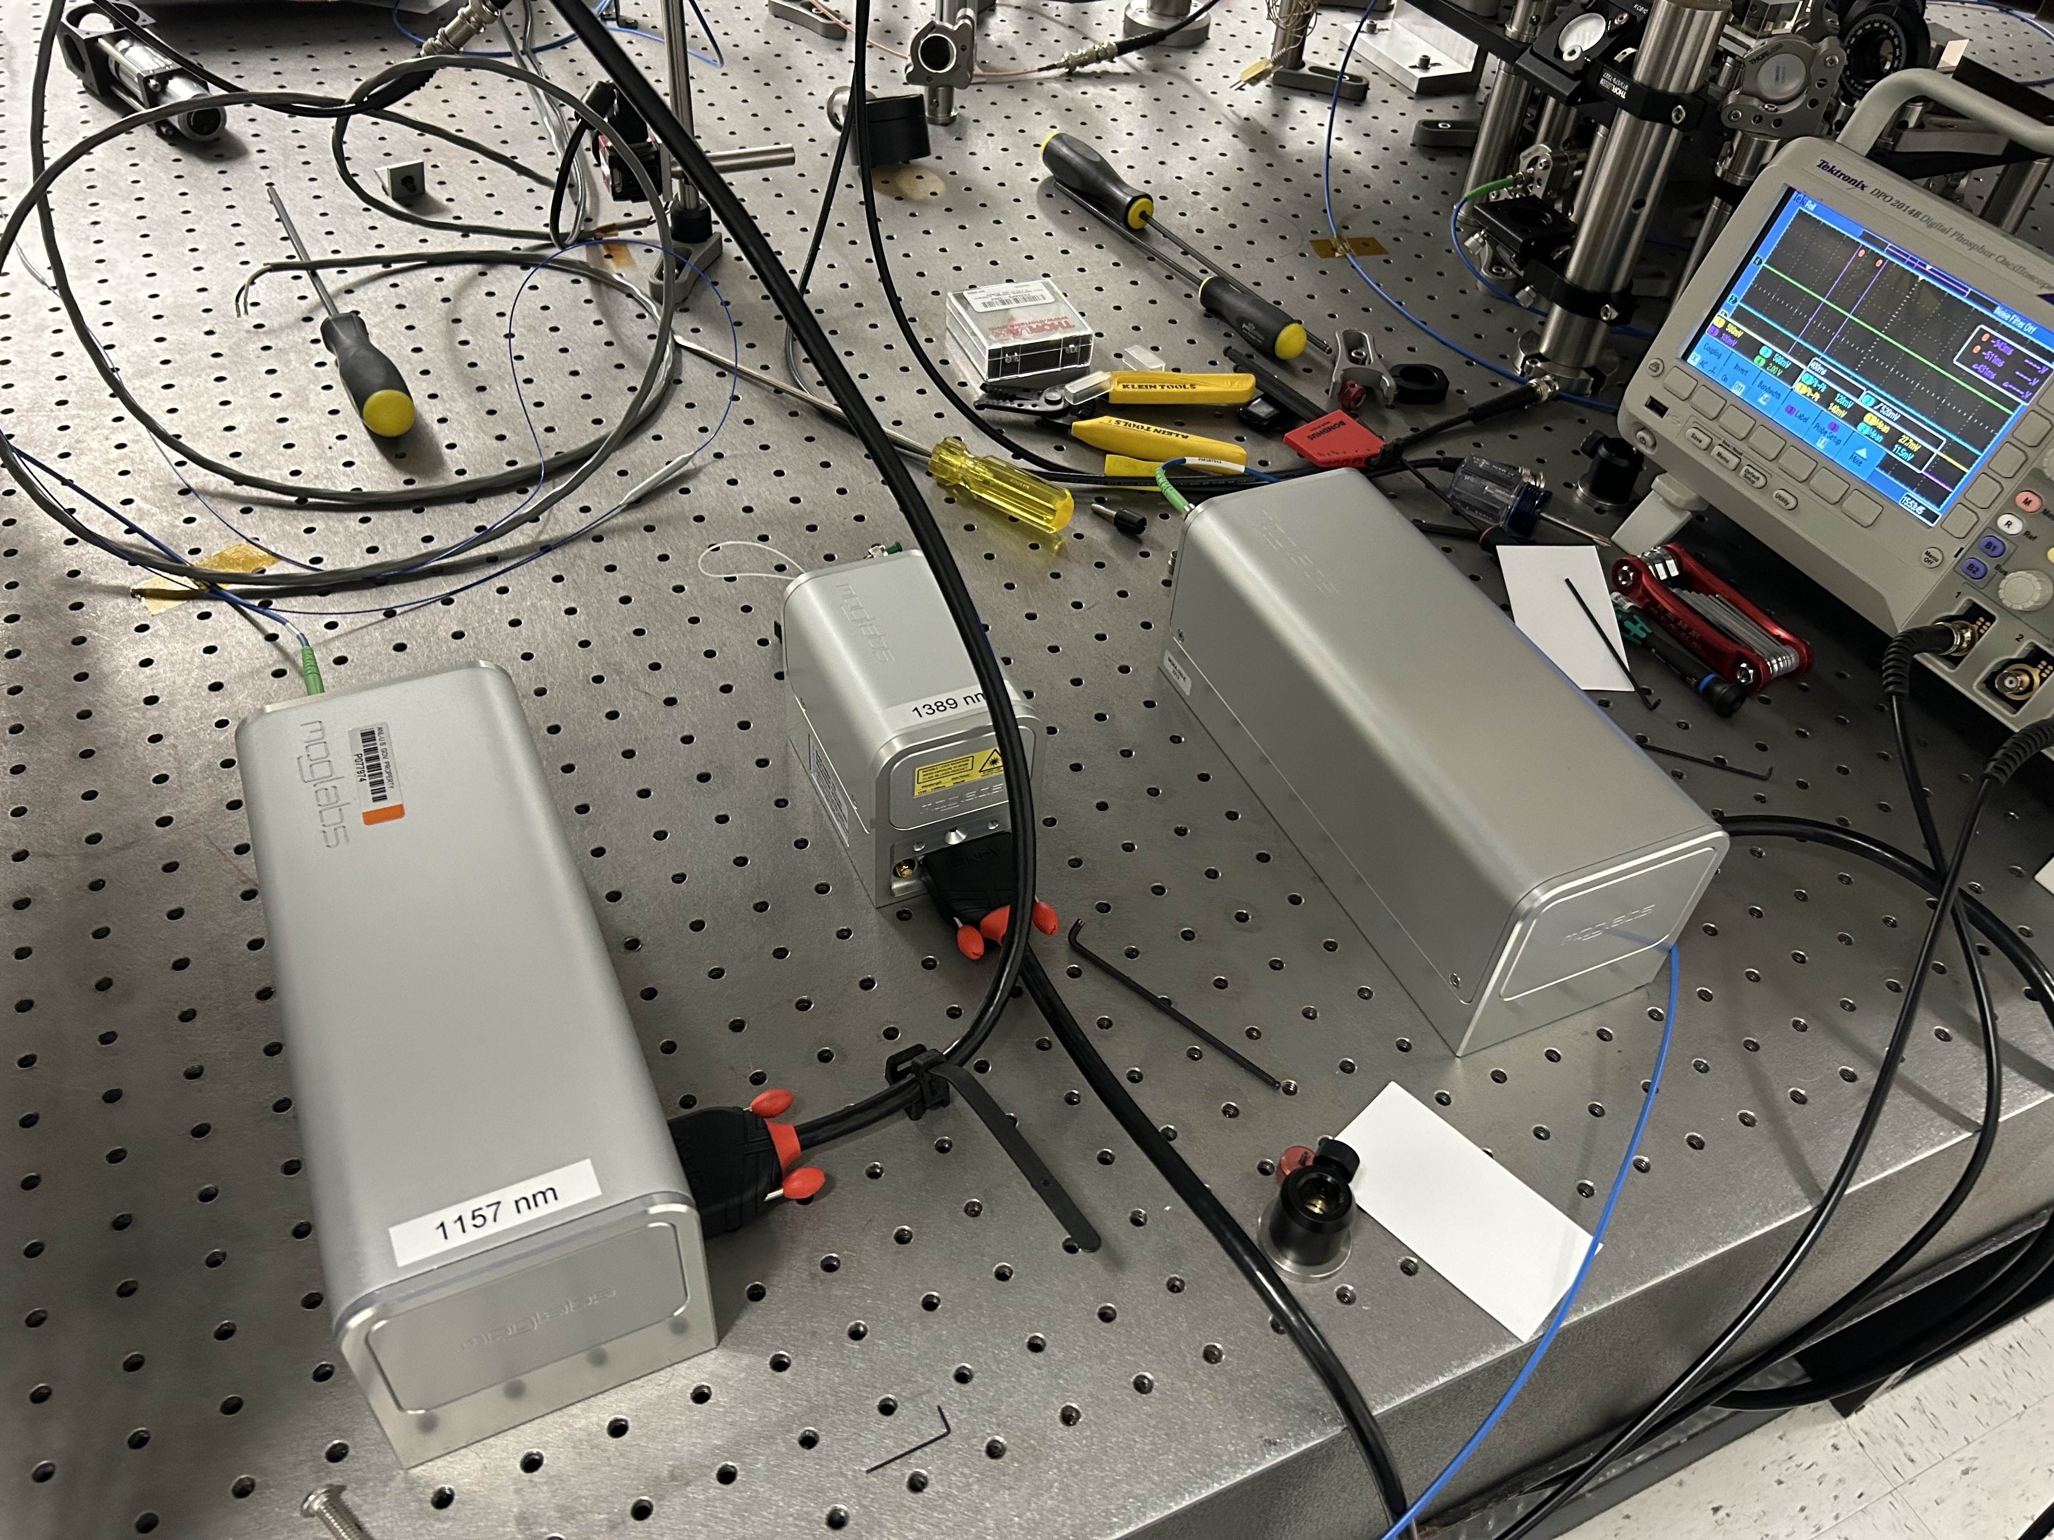
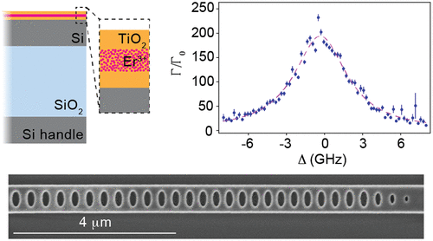
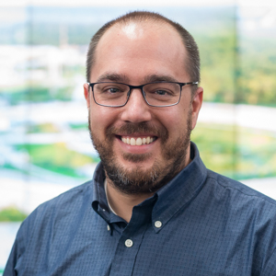
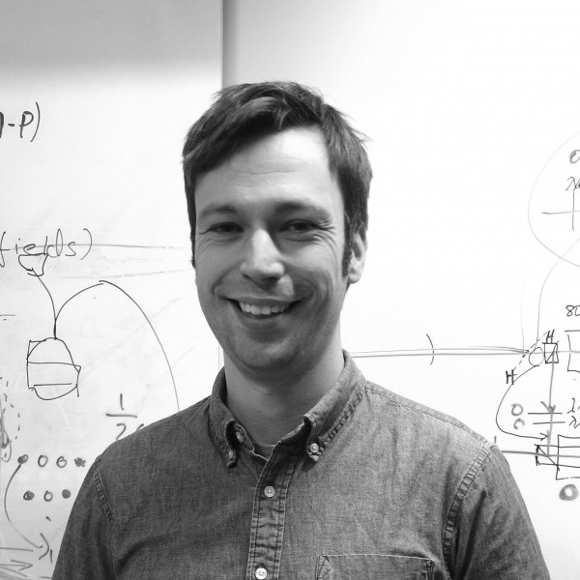

Yb Atoms, Superconducting Devices, Er³⁺ Ions

Slide 13
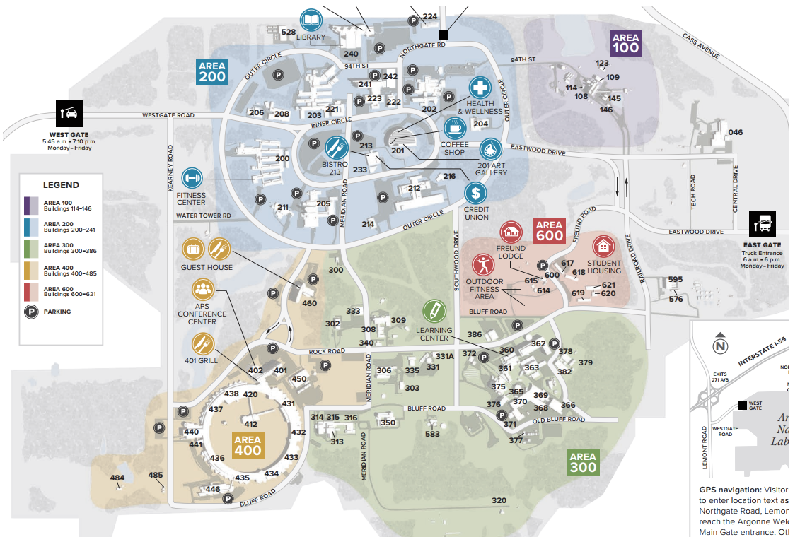
Argonne Fiber Network
1.10 km
Notes:
Fiber lines are only for illustration purpose, NOT real physical topology.
Each line represents at least one pair of fibers.
241/A041
Er³⁺
203/H138
Yb
2.87 km
2.72 km
360/C216
µWave
440/D116
2.19 km

Slide 14
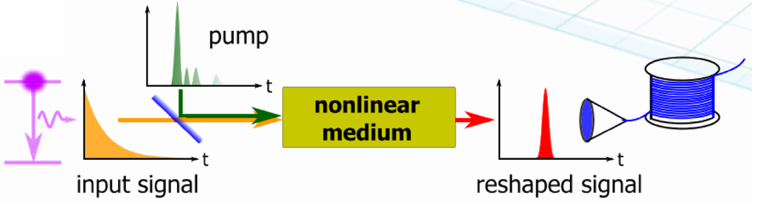
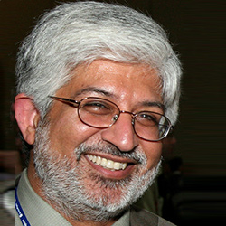

Quantum Frequency Conversion
1452 nm
Amp
SHG: 726 nm
input
Pump
1389 nm
DFG
1520 nm signal

Slide 15
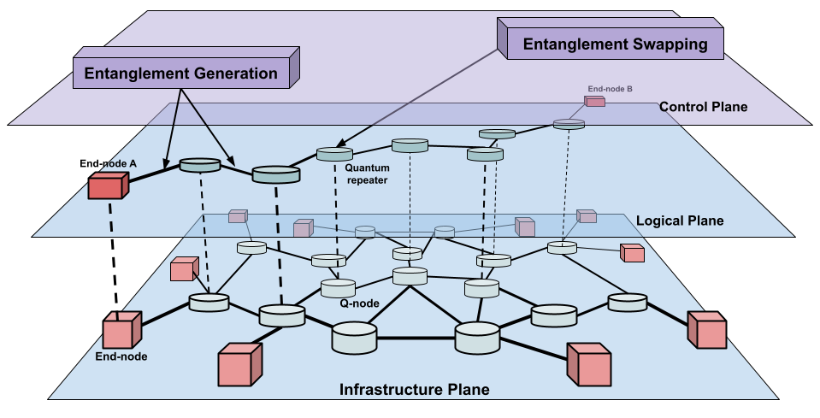
InterQnet-Scale
Notes:
The goal of InterQnet-scale is to understand the tradeoffs in various architectural choices, alternative protocol design, control parameter optimizations through at-scale simulation studies.

Slide 16
A Potential Quantum Network Stack

Slide 17
Schematic of a Control Protocol

Slide 18
SeQUeNCe: Simulator of Quantum Network Communication
Modularized discrete event simulator with a clear separation of functionality
Simulates quantum communication at photon-level with picosecond accuracy
Allows simulations with different parameters, protocols, topologies, and network architectures
Hardware models of single-atom memories, entanglement generation, swapping, and purification protocols
Notes:
SeQUeNCe is an open source, discrete-event simulator for quantum networks. It uses the properties and functionalities of each element in the quantum network such as photon, QM, EG, QNo, QCh, and CC to model and simulate them. It uses a modular framework with clear separation of functionality. These modules can be used as-is to test network parameters and topologies or can be edited to add and test additional functionality. RM and NM modules use classical control messages to manage allocation of network resources. EM and HW modules encompass protocols and hardware operations that act on qubits that are located in quantum memories or in photons at telecommunication wavelengths in optical network links.

Slide 19
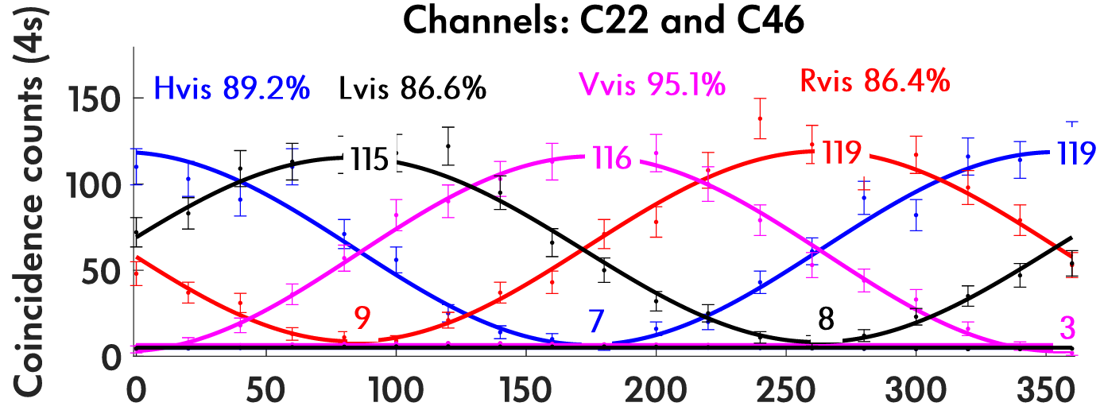
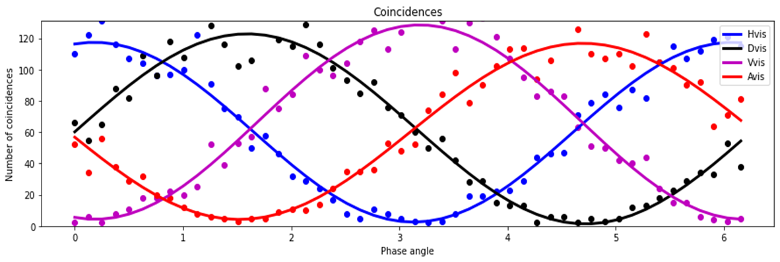
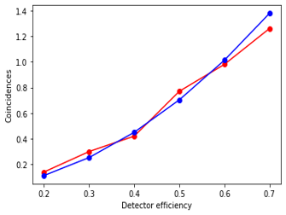
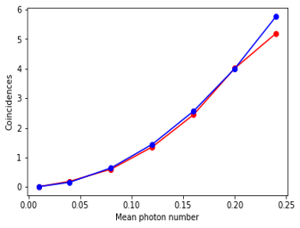
Faithful Simulation of coexistence Experiments
Model the entanglement distribution experiment in
  Model noise sources – Multi-pair emissions, depolarization and attenuation
  Model devices like polarization analysers, accounting both coincidence & singles counts
  Develop quantum state representation satisfying quantum properties (truncated commutation)
  Modelling a beamsplitter to assess the action of devices on photon numbers and polarization
Computational aspects
  Entanglement distribution experiment was modeled in multi-processed environments to simulate multiple configurations simultaneously
  Sparse algebra was used to implement joint polarization-photon number states to make use of the sparse nature of operators
Fig. 1
[1] Ramesh, Anirudh, et al. "Wavelength-Selective Distribution of Polarization Entanglement over Deployed Fiber." CLEO: Fundamental Science. Optica Publishing Group, 2023.
Fig. 2

Slide 20
Summary
Quantum communications from a scientific concept to small-scale experiments and more recently metropolitan-scale demonstrations.
Scalability has now emerged as a major challenge
  Number & heterogeneity of nodes, distance between nodes, diversity of applications, and number of users.
InterQnet - advance scalable quantum communications through a comprehensive approach that improves devices, error & architecture
InterQnet-Achieve - practical realization of a heterogeneous quantum network by building & integrating a prototype repeater with an error mitigation scheme & centralized automated network control system
InterQnet-Scale - a systems study of architectural choices for scalable networks by developing futuristic models of quantum network devices, advanced error correction schemes, and entanglement protocols.

Slide 21
Questions / Discussion

