Slide 1
Post Quantum Security for Space Communications
Ayesha Khalid

Slide 2
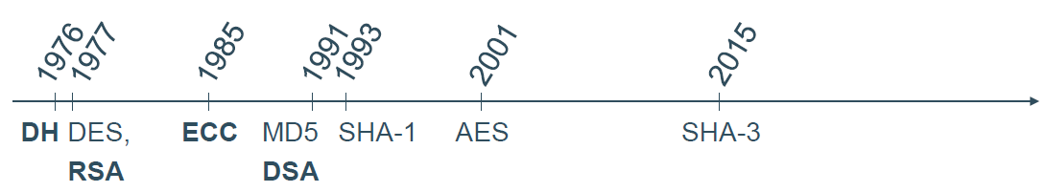
Motivation
The security of RSA is based on the computational hardness of integer factorization
The security of DH Diffie Hellman) key exchange and DSA (Digital Signature Algorithm ) is based on the computational hardness of the discrete logarithm problem
The security of ECC Elliptic Curve Cryptography ) is based on the computational hardness of the elliptic curve discrete logarithm problem
Notes:
terrestrial network is not available (due to lack of cellular/broadband coverage, natural disasters, geo-political unrest, jamming attacks)
Reportedly used during the recent Ukraine invasion to control surveillance drones for monitoring adversary movements, concentrations

Slide 3
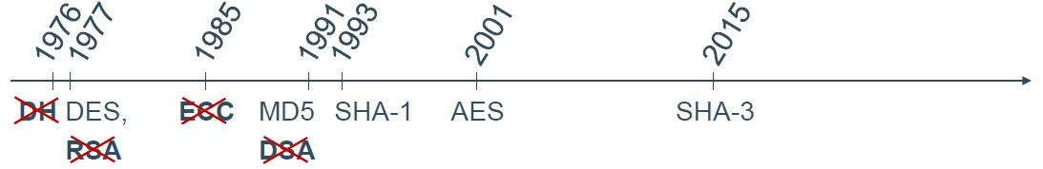
Motivation
The security of RSA is based on the computational hardness of integer factorization
The security of DH Diffie Hellman) key exchange and DSA (Digital Signature Algorithm ) is based on the computational hardness of the discrete logarithm problem
The security of ECC Elliptic Curve Cryptography ) is based on the computational hardness of the elliptic curve discrete logarithm problem
When quantum computers become available, Shor’s algorithm can be used to calculate discrete logarithms and to do integer factorization in polynomial time
Notes:
terrestrial network is not available (due to lack of cellular/broadband coverage, natural disasters, geo-political unrest, jamming attacks)
Reportedly used during the recent Ukraine invasion to control surveillance drones for monitoring adversary movements, concentrations

Slide 4
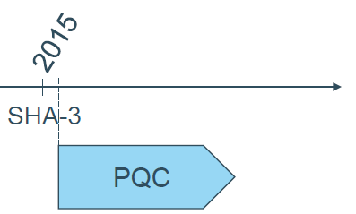
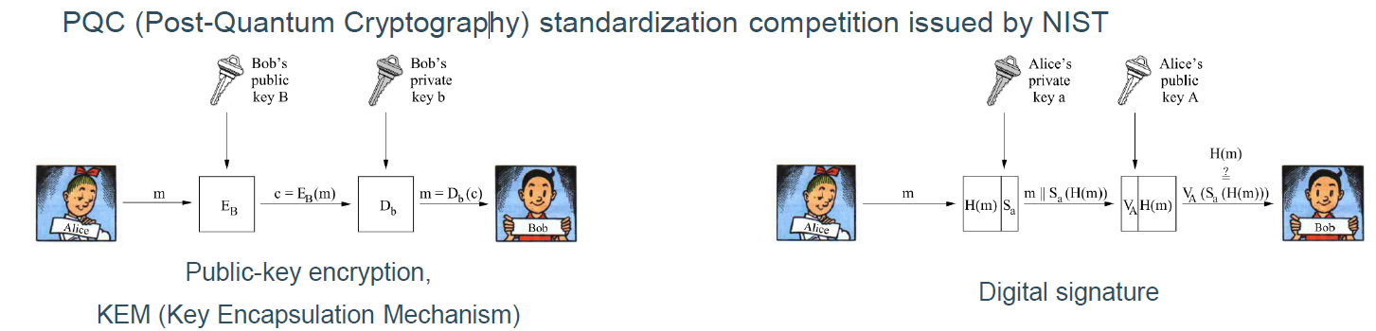
Motivation
Notes:
terrestrial network is not available (due to lack of cellular/broadband coverage, natural disasters, geo-political unrest, jamming attacks)
Reportedly used during the recent Ukraine invasion to control surveillance drones for monitoring adversary movements, concentrations

Slide 5
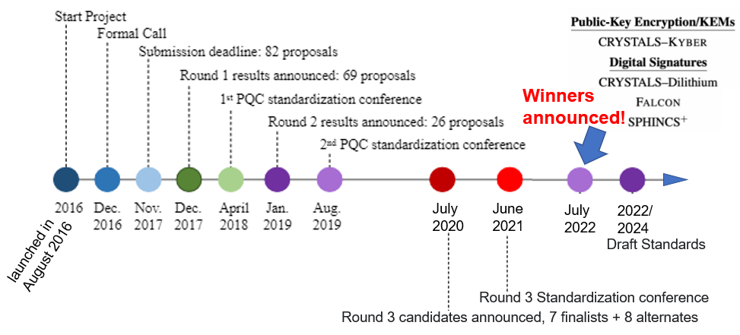
NIST Post Quantum Cryptography (PQC)
“ A quantum computer capable of breaking 2000-bit RSA in a matter of hours could be built by 2030 for a budget of about a billion dollars. ” – NIST Report on PQC, April 28, 2016
Announcing PQC Candidates to be Standardized, Plus Fourth Round Candidates | CSRC (nist.gov)
5
Notes:
terrestrial network is not available (due to lack of cellular/broadband coverage, natural disasters, geo-political unrest, jamming attacks)
Reportedly used during the recent Ukraine invasion to control surveillance drones for monitoring adversary movements, concentrations

Slide 6
Why PQC for Space?
Critical national sectors and infrastructure depends on space systems today.
Eye in the sky, used in aviation/ Maritime, air-borne warfare tracking, military surveillance. Used during Ukraine invasion ¹
Beyond Earth Observation (EO) for precision agriculture, Oil and gas sector, weather forecasting, mining etc.
Space missions have much longer space life compared to most terrestrially used electronics (5-20 years) .
Requires future oriented and long lasting security solutions against quantum threat to security.
A successful security breach could have high cost/impact making critical national assets vulnerable.
[1] The Independent https://www.independent.co.uk/news/world/europe/elon-musk-ukraine-starlink-b2282465.html
Notes:
terrestrial network is not available (due to lack of cellular/broadband coverage, natural disasters, geo-political unrest, jamming attacks)
Reportedly used during the recent Ukraine invasion to control surveillance drones for monitoring adversary movements, concentrations

Slide 7



CSIT’s contribution to PQC
Secure Architectures of Future Emerging Cryptography (SAFEcrypto)
Agile Quantum Safe Communications (AQuaSec)
Quantum Communications Hub
(Phase 1 and 2)
Notes:
What happens when quantum computers become a reality 10/15 years from now?

Slide 8
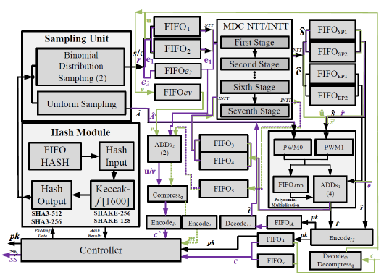
PQC Acceleration on FPGA Devices
Field Programmable Gate Arrays (FPGAs) are used for high-speed applications. The number theoretic transform (NTT) is a bottle neck for most of the PQC algorithms. It is accelerated via efficient pipelining exploration for a High-performance CRYSTALS-Kyber Accelerator.
High Performance Kyber Accelerator (Artix-7 XC7A200)¹:
Security Level 1:
Total time (KeyGen+Enc+Dec) = 22.6μs
Security Level 3:
Total time (KeyGen+Enc+Dec) = 34.1μs
Security Level 5:
Total time (KeyGen+Enc+Dec) = 49μs
25-51% speed-up over state-of-the-art
50-75% reduction in DSPs at comparable security levels
[1] Efficient Pipelining Exploration for A High-performance CRYSTALS-Kyber Accelerator, Accepted in IEEE Transactions on Computing, 2023.
Notes:
Lightweight hardware ECC processor requires only 20k GEs to 29.7k GEs for GF(2¹⁶³) to GF(2²³³) with respective classical-security levels of 80-bit to112-bit,
R-Binary LWE (R-BLWE) is presented in 2016 specially targeting an IoT (Q-bit 73).

Slide 9
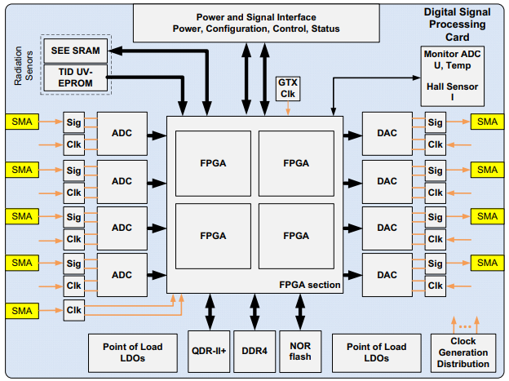
SEQURE-SAT: SEcure QUantum REsilient
SATellite
SEQURE-SAT aims to design and develop a novel low-cost, low-power, space radiation tolerant, embedded processor hardware core for providing quantum resilient secure communication between satellites and ground stations.
Salient features
NIST competitions’ winner Post quantum cryptography (PQC) schemes.
Based on COTS FPGAs ensuring low cost, high performance and reconfigurability.
Faults/ radiation tolerant design exploration
  Approximation for low power design
  Fault protection by Error correcting codes
Satellite On board processor
SECURE SAT

Slide 10
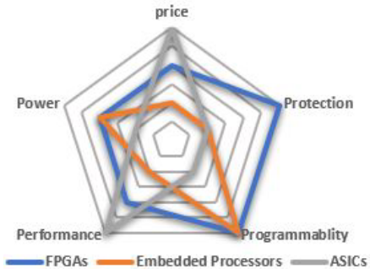
Why FPGAs for on-board security processing?
Currently, there are no mission tailored ASICs in the market for space applications. Processors do not meet the required performance.
A Field programmable gate array (FPGA) based on board security processing offers
In-orbit reconfiguration any time from deployment of the system until End-Of-Life (EOL)
High throughput performance
The cost increase and performance per watt degradation for radiation tolerant (RT) FPGAs is orders of magnitude worse. There is a size penalty and often long lead times.
SEQURE-SAT will target the use of COTS FPGAs

Slide 11
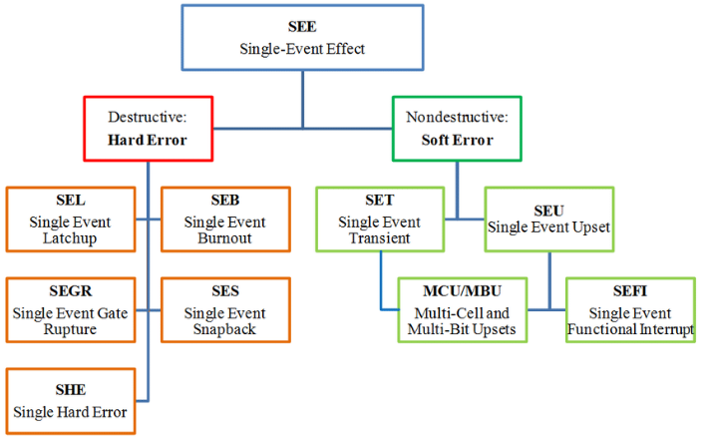

Radiation effects on Space Systems
Space is Hard and Ruthless due to large operating temperature ranges; high vibration, shock and sound pressure and high Ionizing radiation environment. This causes Single event effect or SEE in space systems
SET
SEU
Radiation effects are Measurable
In low Earth orbit (LEO) SEU rates of the order of 10⁻⁶ bit⁻¹ day⁻¹ can be expected*
* Underwood, C. I. The single-event effect behaviour of commercial-off-the-shelf memory devices–A decade in low Earth Orbit. IEEE Transactions on Nuclear Science.
Notes:
Revolutionizing effect drug discovery, health, weather forecasting, financial data etc

Slide 12

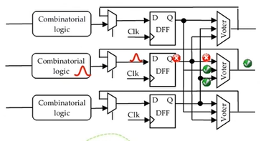
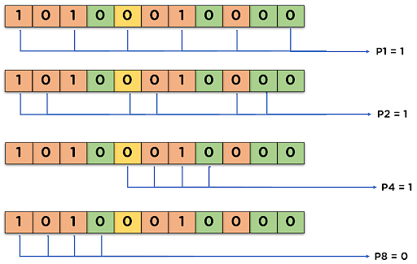
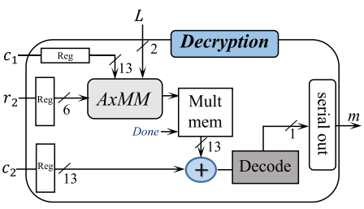
Fault tolerant PQC for Space
Triple modular redundancy (TMR) is the most reliable and most costly fault mitigation technique for single or multiple event upsets.
You are
here
Performance
Power Consumption
Triple modular redundancy Error correcting codes Approximation of PQC kernels
Notes:
Lightweight hardware ECC processor requires only 20k GEs to 29.7k GEs for GF(2¹⁶³) to GF(2²³³) with respective classical-security levels of 80-bit to112-bit,
R-Binary LWE (R-BLWE) is presented in 2016 specially targeting an IoT (Q-bit 73).

Slide 13
Fault tolerant PQC for Space
Triple modular redundancy (TMR) is the most reliable and most costly fault mitigation technique for single or multiple event upsets.
You are
here
Performance
Error correcting codes and Safe Finite state machines modelling can be used for mil/aero and other safety-critical applications, having a moderate hardware overhead.
Power Consumption
Triple modular redundancy Error correcting codes Approximation of PQC kernels
Notes:
Lightweight hardware ECC processor requires only 20k GEs to 29.7k GEs for GF(2¹⁶³) to GF(2²³³) with respective classical-security levels of 80-bit to112-bit,
R-Binary LWE (R-BLWE) is presented in 2016 specially targeting an IoT (Q-bit 73).

Slide 14
Fault tolerant PQC for Space
Triple modular redundancy (TMR) is the most reliable and most costly fault mitigation technique for single or multiple event upsets.
You are
here
Performance
Error correcting codes and Safe Finite state machines modelling can be used for mil/aero and other safety-critical applications, having a moderate hardware overhead.
The inherently error tolerant nature of some of the post quantum cryptography problems can be exploited to make efficient, fault tolerant solutions.
Power Consumption
Triple modular redundancy Error correcting codes Approximation of PQC kernels
Notes:
Lightweight hardware ECC processor requires only 20k GEs to 29.7k GEs for GF(2¹⁶³) to GF(2²³³) with respective classical-security levels of 80-bit to112-bit,
R-Binary LWE (R-BLWE) is presented in 2016 specially targeting an IoT (Q-bit 73).

Slide 15
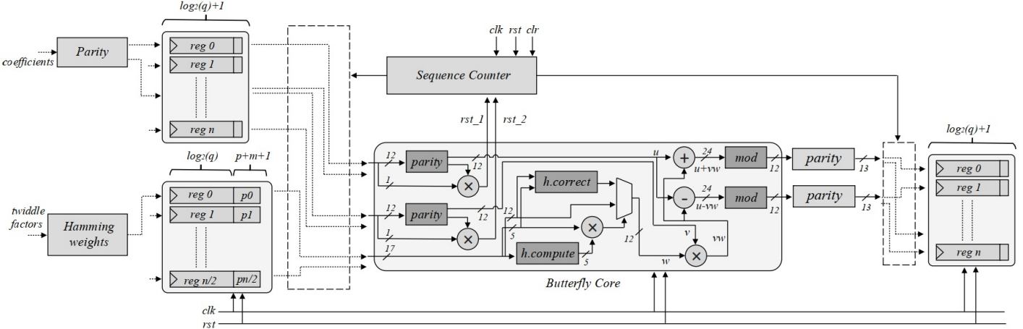
Hybrid Fault Mitigation Technique
We applied a hybrid fault mitigation strategy on the number theoretic transform (NTT) core of the Kyber accelerator based on data parity and hamming codes.
On a Virtex-7 FPGA platform we benchmark a 29.2% increased area penalty, compared to the standard implementations.
Khan, Safiullah, et al. Efficient, Error-Resistant NTT Architectures for CRYSTALS-Kyber FPGA Accelerators. Accepted IEEE VLSI SoC 2023.
Notes:
The parity of each data coefficient is computed at the time of updating the registers and compared during NTT butterfly computations. In case of mismatch, the NTT operation is restarted.
For the twiddle factors hamming codes are used to both detect and correct SEU based errors if any.

Slide 16
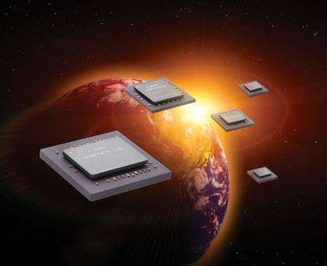
Conclusion /Outlook
Critical national sectors and infrastructure depends on space systems.
A successful security breach would result in high cost/impact leading to making national assets vulnerable.
Our next generation space-enabled services should be prioritised to achieve resilience against a quantum enabled adversary.
SEQURE-SAT is an FPGA based on-board security processing solution that promises
Low SWaP-C
Customized space radiation tolerance
On board reconfiguration
16

Slide 17
Thank you

Slide 18
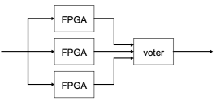
Fault tolerance by Redundancy of design
Triple modular redundancy (TMR) is the most reliable and most costly fault mitigation technique for single or multiple event upsets.
Costly in terms of Hardware (Resource triplication)
Combination of hardware/ time redundancy
You are
here
Performance
Power Consumption
Triple device redundancy
Triple modular redundancy

Slide 19
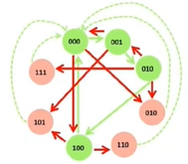
Fault tolerance by Error Correcting Codes
Several techniques are used for fault tolerance in FPGAs mil/aero and other safety-critical applications.
Safe Finite state machines modelling
Error correcting codes
Selective TMR to critical logic
You are
here
Performance
Power Consumption
One Hot Safe FSM encoding
Error Correction codes
A fault-tolerant model of AES based on hamming codes over s-boxes reportedly had a 49% higher area overhead and a 152% increase in power consumption[1].
[1] Fault-Tolerant Encryption for Space Applications, IEEE TRANSACTIONS ON AEROSPACE AND ELECTRONIC SYSTEMS

Slide 20
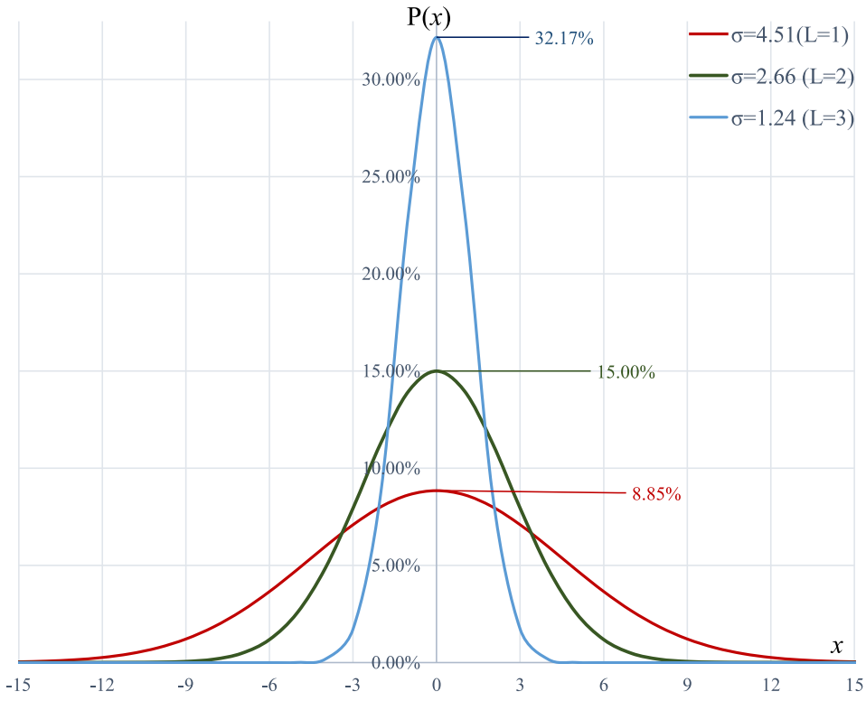
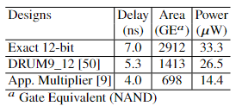
Fault tolerance by Algorithmic Approximation
LWE problem is inherently approximate. The message decryption carries out threshold decoding from the added Gaussian noise.
You are
here
Performance
Approximate R-LWE decoder
Power Consumption
Efficiency via approximation
PDFs for Gaussian Distributions
Approximate modular multiplication on 45nm CMOS, achieves the area and power reduction by 35% and 23%, respectively as compared to the smallest exact R-LWE*.
"AxRLWE: A multilevel approximate Ring-LWE co-processor for lightweight IoT applications." IEEE Internet of Things Journal Journal 9.13 (2021): 10492-10501.

