Slide 1
Quantum security evaluation and
Migration plan for PQC in Korea
HackTheon Joint Conference 2024
2024.06.19
Cryptography Engineering Research Section
Dr. Yousung Kang

Slide 2
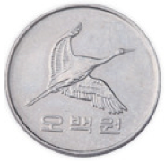
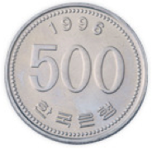
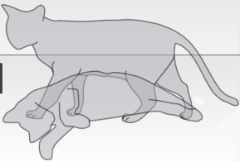



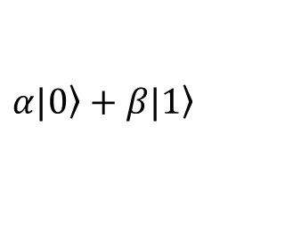



















Quantum computer…
Digital computer
Quantum computer
V.S.
Bit
unit
Qubit
$$0$$
$$1$$
$$α|\left.0\right\rangle +β|\left.1\right\rangle$$
$${|α|}^{2}$$
$${|β|}^{2}$$
prob. of 1
prob. of 0
$$000$$
$$F(000)$$
$$001$$
$$F(001)$$
$$010$$
$$F(010)$$
$$011$$
$$F(011)$$
calculation
$$\frac{1}{2\sqrt{2}}\left(|\left.000\right\rangle +|\left.001\right\rangle +⋯+|\left.111\right\rangle \right)$$
$$100$$
F
$$F(100)$$
$$101$$
$$F(101)$$
$$U_{F}$$
$$110$$
$$F(110)$$
$$\frac{1}{2\sqrt{2}}\left(|\left.000\right\rangle |\left.F(000)\right\rangle +|\left.001\right\rangle |\left.F(001)\right\rangle +⋯+|\left.111\right\rangle |\left.F(111)\right\rangle \right)$$
$$111$$
$$F(111)$$
8=2³ times
1 time

Slide 3
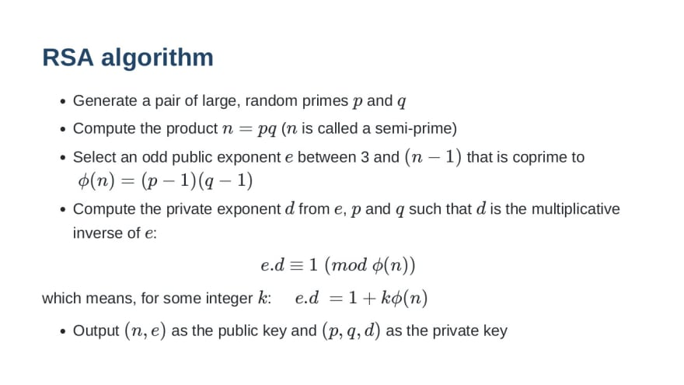
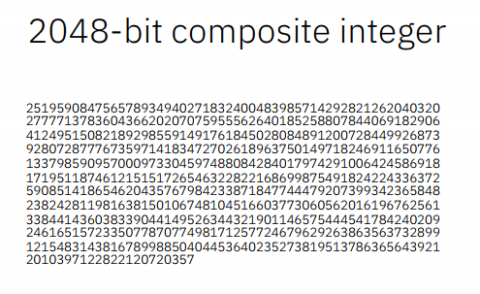
RSA algorithm…
Expected computation time
-> Millions of years by digital computer
-> Hours by Shor’s quantum algorithm and quantum computer

Slide 4
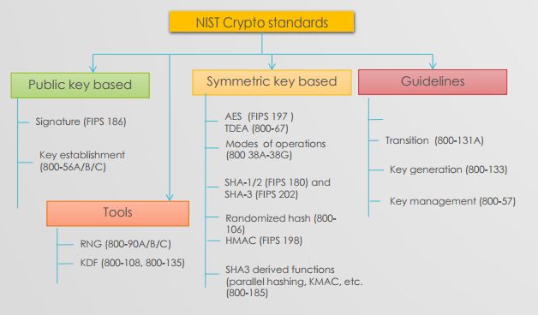

What happens? Public key…
    RSA → (X)
    Elliptic Curve Cryptography (ECDSA) → (X)
    Diffie-Hellman Key Exchange → (X)

Slide 5
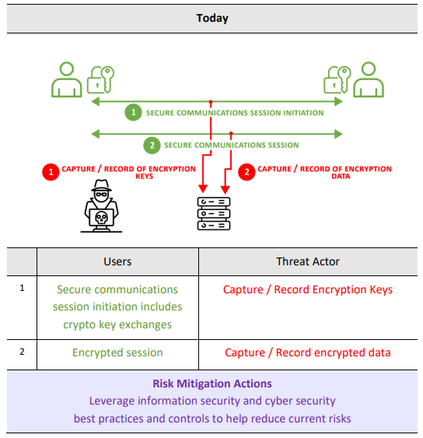
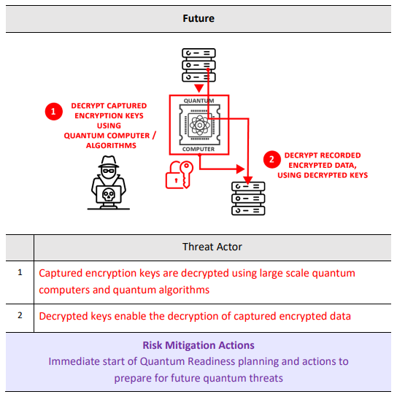
Why dangerous? Quantum risk…
Harvest now, decrypt later
(2024)
(2035)
Source : Canadian National Quantum-Readiness, BEST PRACTICES AND GUIDELINES, Authored by Quantum-Readiness Working Group (QRWG) of the Canadian Forum for Digital Infrastructure Resilience (CFDIR), Version 02 – June 17, 2022

Slide 6
So… Quantum security!!!
What are some ‘Security’-related terms that contain the word ‘Quantum’?
Quantum Key Distribution
Quantum Cryptography
Quantum Cryptography Communication
Quantum Random Number Generator
Quantum (Secure) Direct Communication
Post-Quantum Cryptography
Quantum Security Evaluation Platform
Quantum device
Quantum device
Quantum computer
Digital computer
Digital computer

Slide 7
NIST(USA) PQC…
NIST Timeline (From 2016)
*This is a tentative timeline, provided for information, and subject to change.
Date
Feb 24-26, 2016 | NIST Presentation at PQCrypto 2016: Announcement and outline of NIST's Call for Submissions (Fall 2016), Dustin Moody
April 28, 2016 | NIST releases NISTIR 8105, Report on Post-Quantum Cryptography
Dec 20, 2016 | Formal Call for Proposals
Nov 30, 2017 | Deadline for submissions
Dec 4, 2017 | NIST Presentation at AsiaCrypt 2017: The Ship Has Sailed: The NIST Post-Quantum Crypto "Competition", Dustin Moody
Dec 21, 2017 | Round 1 algorithms announced (69 submissions accepted as "complete and proper")
Apr 11, 2018 | NIST Presentation at PQCrypto 2018: Let's Get Ready to Rumble - The NIST PQC "Competition", Dustin Moody
April 11-13, 2018 | First PQC Standardization Conference - Submitter's Presentations
January 30, 2019 | Second Round Candidates announced (26 algorithms)
March 15, 2019 | Deadline for updated submission packages for the Second Round
May 8-10, 2019 | NIST Presentation at PQCrypto 2019: Round 2 of the NIST PQC "Competition" - What was NIST Thinking? (Spring 2019), Dustin Moody
August 22-24, 2019 | Second PQC Standardization Conference
July 22, 2020 | Third Round Candidates announced (7 Finalists and 8 Alternates)
October 1, 2020 | Deadline for updated submission packages for the Third Round
June 7-9, 2021 | Third PQC Standardization Conference
July 5, 2022 | Announcement of Candidates to be Standardized and Fourth Round Candidates
October 1, 2022 | Deadline for updated submission packages for the Fourth Round
Nov 29-Dec 1, 2022 | Fourth PQC Standardization Conference (Virtual)
August 24, 2023 | Three Draft FIPS released for public comment Draft FIPS 203, Module-Lattice-Based Key-Encapsulation Mechanism Standard Draft FIPS 204, Module-Lattice-Based Digital Signature Standard Draft FIPS 205, Stateless Hash-Based Digital Signature Standard
April 10-12, 2024 | Fifth PQC Standardization Conference
KEM | CRYSTALS-Kyber
Digital Signature | CRYSTALS-Dillithium Falcon SPHINCS+
Source: NIST website, https://csrc.nist.gov/Projects/post-quantum-cryptography/workshops-and-timeline

Slide 8
NSR(Korea) KpqC…
KpqC Timeline (From 2021)
Date
May 21. 2021 | KpqC releases plans (The 1st KpqC Workshop, @Seoul)
Nov. 18. 2021 | Formal Call for Proposals (The 3rd KpqC Workshop, @Pyeongchang)
Nov. 25. 2021 | Open official website
Feb. 18. 2022 | Deadline for submissions (Round 0)
Mar. 18. 2022 | Evaluation committee and Round 0 algorithms announced
Oct. 31. 2022 | Round 1 Deadline for submissions (16 submissions accepted)
Dec. 05. 2022 | Start evaluation (international and domestic)
Dec. 26. 2022 | Open KpqC Bulletin Board (Discussion platform)
Dec. 07. 2023 | Round 2 candidates announced
Feb. 23. 2024 | Round 2 Deadline for submissions (8 submissions accepted)
Apr. 04. 2024 | Start evaluation (international and domestic)
KEM | SMAUG-T PALOMA REDOG NTRU+
Digital Signature | HAETAE AIMer MQ-Sign NCC-Sign
Source: KpqC website, Reconstructed by ETRI

Slide 9
ETRI’s QCrypton – motivation
We want to know the REAL Quantum Security
of Cryptographic algorithms such as RSA and PQCs.
How about QSEP-CA?
(to analyze the physical quantum resources
for cracking cryptographic algorithms)

Slide 10
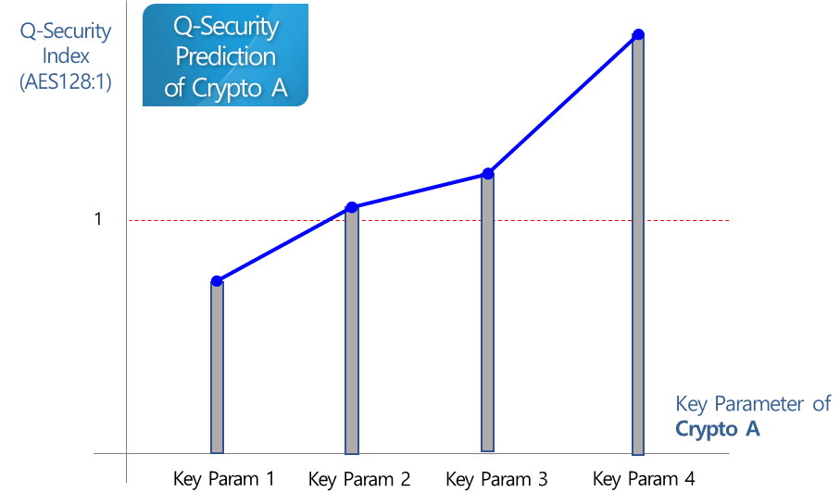
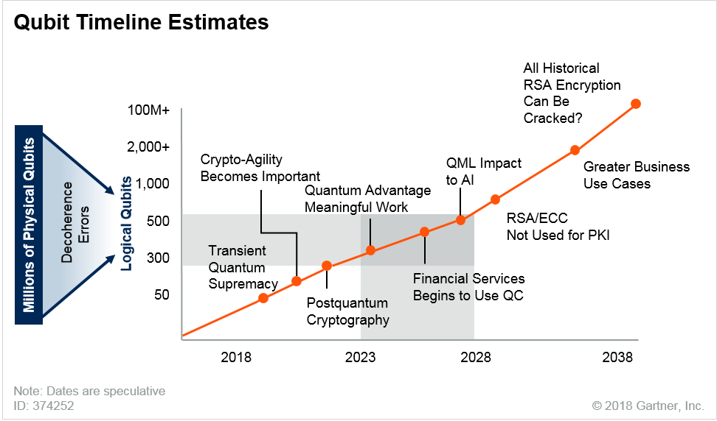



ETRI’s QCrypton – concept
What is QSEP-CA?
Quantum Security Evaluation Platform for Cryptographic Algorithm
QSEP-CA gives us the analysis result about how much secure cryptographic algorithms are in quantum environment, based on the quantity of quantum resources necessary for breaking the algorithms
GOAL of QSEP-CA
First Goal: Quantum security analysis of crypto algorithm
Final Goal: Prediction of when CRQC* will emerge
RSA Encryption
can be Cracked?
* CRQC: Cryptographically Relevant Quantum Computer (Source: Quantum_FAQs_20210804.pdf, NSA)

Slide 11








ETRI’s QCrypton – operation
QCrypton
Quantum Analysis Algorithm for Crypto.
Q-code verification
Q-resource analysis
Q-security evaluation
OpenQASM 2.0
Q-security comparison and result graph
Q-code programming
$$\left\langle Q | Crypton\right\rangle$$
Compile-level
Q-resource analysis
$\left\langle Q | Crypton\right\rangle$
Q-Lib
(RSA,ECC,AES,PQC,etc)
Scale-down
mechanism for Q-code verification
$$\left\langle Q | Crypton\right\rangle$$
FTQC-level
Q-resource analysis
$\left\langle Q | Crypton\right\rangle$
Q-Arith.
($GF\left(2^{n}\right)$,$GF\left(p\right)$,NTT, etc.)
$$\left\langle Q | Crypton\right\rangle$$
compiling
$$\left\langle Q | Crypton\right\rangle$$
Q-HW-level
Q-resource analysis
$$\left\langle Q | Crypton\right\rangle$$
Q-code verification
$\left\langle Q | Crypton\right\rangle$ FTQC/HW
($QEC, etc$.)
RSA, ECDSA, AES, SHA3
Lattice/Code/MQ/Hash based PQC
Quantum Computing Platform (ETRI QPlayer, IBM Qiskit, AWS Braket, etc)

Slide 12



ETRI’s QCrypton – evaluation results
Graph for Users on Quantum Security Evaluation Results
Resource
Estimate
(Qubits)
PQC B
Resource
Estimate
(exe. time)
PQC B
Q-security evaluation
PQC A
AES
AES
PQC A
Q-security comparison to AES case
PQC C
PQC C
Key Parameter
Key Parameter
Q-Security Prediction of Crypto A
Resource
Estimate
(Q-gates)
PQC B
PQC A
Q-Security
Index
(AES128:1)
AES
PQC C
1
Key Parameter
Key Param 1
Key Param 2
Key Param 3
Key Param 4
Key Parameter of Crypto A

Slide 13
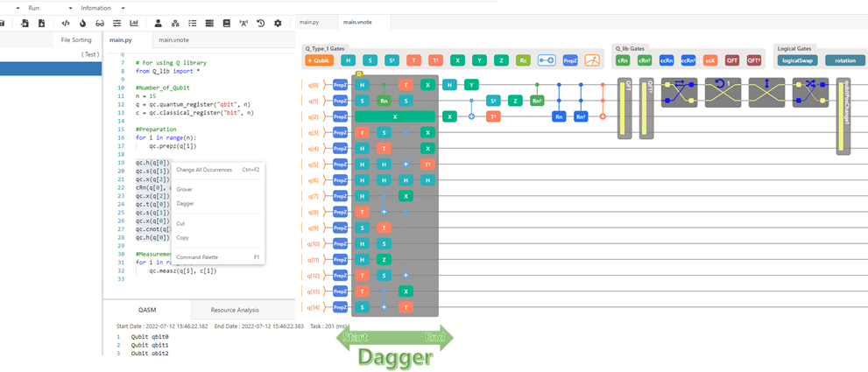
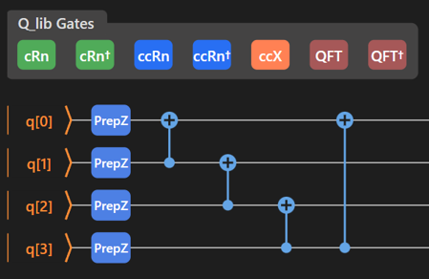
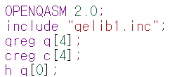
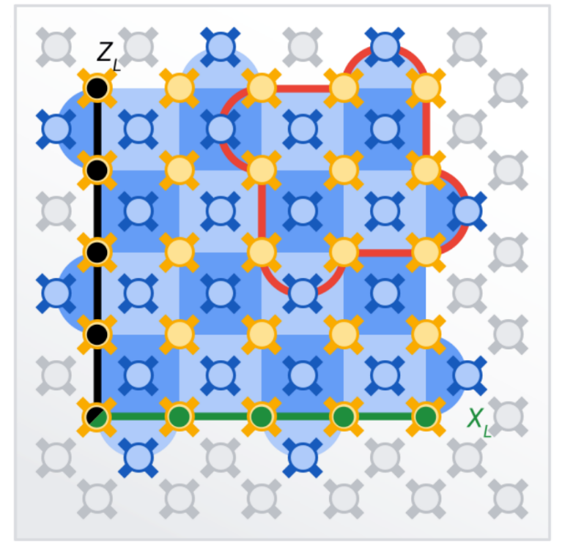
ETRI’s QCrypton – core features
1
Visualized High-Level Programming
for Quantum Algorithm
2
Quantum Libraries of the Arithmetic
for Cryptographic Algorithms
3
Quantum Resource Analysis
in QASM, FTQC levels, and QHW Levels

Slide 14

Migration plan for PQC in Korea
Migration roadmap by NIS and MSIT
NIS: National Intelligence Service
MSIT: Ministry of Science and ICT
Establishment of national policy for PQC transition
Running PQC transition
Advancing crypto-infrastructure to respond to quantum threats
~’24
~’30
~’35
Core tech & policy
❶ Developing core technologies
❷ Reorganizing crypto-policy
❸ Running PQC transition procedure
Social & Human resources
❹ Supporting PQC transition
❺ Developing industry/human resources
❻ Advancing digital signature infrastructure

Slide 15


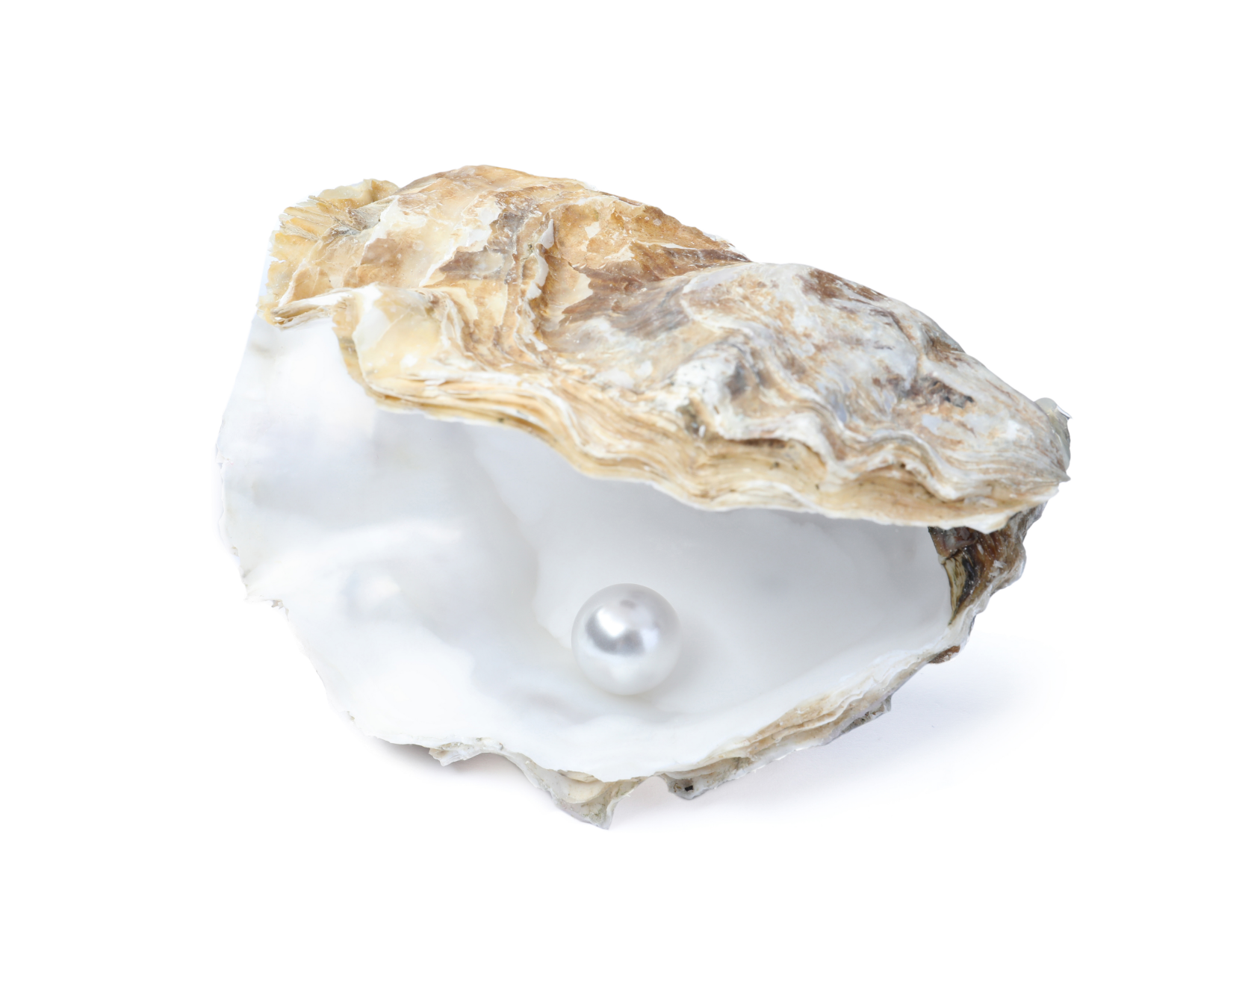
Conclusion
A pearl is worthless as long as it is in its shell
- Quantum security analysis
- PQC transition plan
Quantum-safe
crypto infrastructure
PQC algorithms
Source of Figures: GettyImagesBank. You may not distribute or resell the content without permission.

Slide 16
Q&A
Q&A.
Thank you for your attention!

