Slide 1

Data hiding in the third millennium: From traditional applications to emerging scenarios
Prof. David Megías – SVCC 2024 – HackTheon Joint Conference
Sejong (South Korea), 19 June 2024

Slide 2
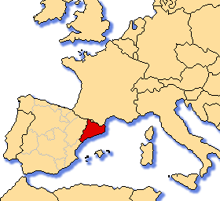
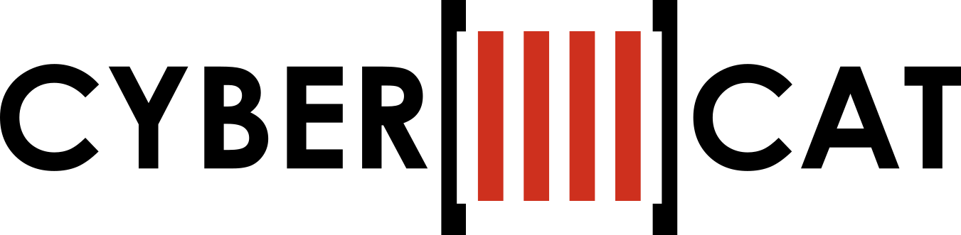
CYBERCAT – CENTER FOR CYBERSECURITY RESEARCH OF CATALONIA (CYBER.CAT)
CYBERCAT aims at becoming a prestigious research center and comprises all Catalan research groups specialized in security and privacy.
2

Slide 3
CYBERCAT – Members
CRISES group, coordinated by Dr. Josep Domingo-Ferrer – Universitat Rovira i Virgili
KISON group, coordinated by Dr. David Megías – Universitat Oberta de Catalunya
ISG group, coordinated by Dr. Miquel Soriano – Universitat Politècnica de Catalunya
MAK group, coordinated by Dr. Jorge Villar – Universitat Politècnica de Catalunya
C&G group, coordinated by Dr. Josep M. Miret – Universitat de Lleida
SENDA group, represented by Dr. Jordi Herrera – Universitat Autònoma de Barcelona
WICOM group, represented by Dr. Vanesa Daza – Universitat Pompeu Fabra
3

Slide 4
CYBERCAT – Indicators 2014-2018
Total number of researchers | 100+
Total number of PhDs | 70+
Number of competitive projects | 35+
Number of defended PhD thesis | 30+
Total number of published articles | 400+
Fundraising | € 4,350,000+
4

Slide 5
CYBERCAT – Mission and ambition
Improve and promote research in cybersecurity and information privacy, coordinated in Catalonia and enforce its international projection.
Reinforce and extend high level training in cybersecurity and information privacy.
Consolidate and tighten research relations among the six different Catalan universities that are part of the consortium.
Ambition: build itself as a center of reference, both nationally and internationally, in cybersecurity and privacy research.
5

Slide 6
CYBERCAT – Strategic goals
Improve the coordination among the different research groups CRISES (URV), ISG (UPC), MAK (UPC), KISON (UOC), C&G (UdL), SENDA (UAB) and WICOM (UPF).
Strengthen and implement a unified high-level research domain in cybersecurity and information privacy within Catalonia.
Simultaneous consolidation of media presence and enhancement of international outreach
Formalization and enhancement of collaboration in PhD programs.
Increase in competitiveness to facilitate joint applications for future high-level research programs, both national and European.
6

Slide 7
7
Outline
Introduction
Traditional applications of data hiding
Properties of data hiding
Emerging data hiding applications (for good and evil)
Summary

Slide 8
Introduction

Slide 9
1. Introduction – What is data hiding?
Security & Privacy Primitives
Cryptographic
Primitives
Unkeyed
Symmetric key
Public key
Arbitrary length hash functions
One-way
permutations
Random
sequences
Symmetric-key
ciphers
Arbitrary length
hash functions
Signatures
Pseudo-random
sequences
Identification
primitives
Public-key
ciphers
Signatures
Identification
primitives
9

Slide 10
1. Introduction – What is data hiding?
Security & Privacy Primitives
Cryptographic
Primitives
Privacy
Primitives
Anonymity & Pseudonimity
Secrecy
Privacy-preserving Data Publishing
Identity Privacy
Location Privacy
Trajectory Privacy
Data Secrecy
Key Secrecy
k-anonymity
ℓ-diversity
t-closeness
ε-differential privacy
10

Slide 11
1. Introduction – What is data hiding?
Security & Privacy Primitives
Cryptographic
Primitives
Privacy
Primitives
Data Hiding
Primitives
Hybrid
Steganography
Digital Watermarking
Linguistic
Technical
Other
Text
Image
Audio
Video
11

Slide 12
1. Introduction – What is data hiding?
Security & Privacy Primitives
Cryptographic
Primitives
Privacy
Primitives
Data Hiding
Primitives
Hybrid
Steganography
Digital Watermarking
Visible
Invisible
Robust
Fragile
Semi-fragile
12

Slide 13
1. Introduction – What is data hiding?
Data hiding includes two distinct branches: digital watermarking and steganography (and some methods that can be considered to be hybrid between both of them).
Common features: a message/watermark is embedded in some cover object so that the existence of the message/watermark cannot be easily noticed.
 | Hidden data related to the cover object | Hidden data unrelated to the cover object
Existence of embedded data is secret | Covert watermarking | Steganography (covert communication)
Existence of embedded data is known | Overt watermarking | Overt embedded communication
13

Slide 14

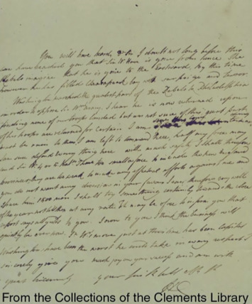
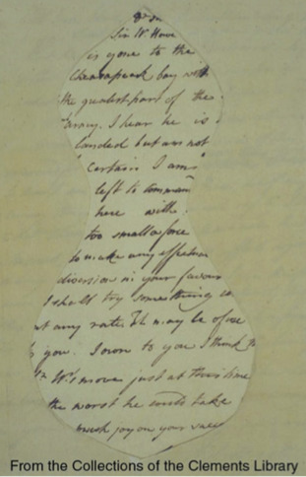
1. Introduction – What is data hiding?
Both watermarking and steganography are ancient techniques.
14

Slide 15

1. Introduction – Data hiding: embedding
10010001100011100011000110010001001000111000010010100100100011000
Message or watermark
Cover image
Stego or watermarked image
15

Slide 16
1. Introduction – Data hiding: extraction/detection
10010001100011100011000110010001001000111000010010100100100011000
Message or watermark
Extraction
process
10010001100011100011000110010001001000111000010010100100100011000
Watermark detected?
True/False
+
1-bit
Watermarking
Stego or watermarked image
Detection
process
16

Slide 17
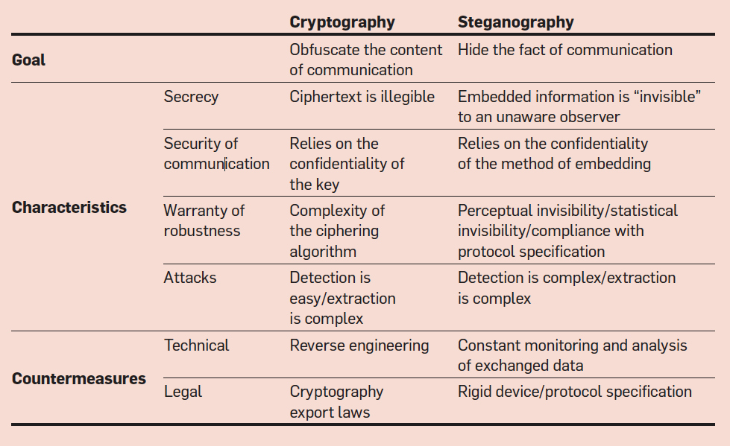
1. Introduction – Steganography vs Cryptography
Cryptography = Kryptos (Secret) + Graphos (Writing)
Steganography = Steganos (Covert or Hidden) + Graphos (Writing)
17

Slide 18
Traditional Applications of Data Hiding

Slide 19

2. Traditional applications of data hiding – Watermarking
Broadcast monitoring
No database of media required. Extraction of the watermark suffices to identify the broadcast (compared to services such as Shazam).
Watermarked video/audio
Monitoring
Service
Company
Broadcasting
station
19

Slide 20


2. Traditional applications of data hiding – Watermarking
Owner identification & proof of ownership
Identifies the owner or copyright holder. Proof of ownership is stronger (can be used in court).
© Leonardo
Watermarking
© Leonardo
20

Slide 21



2. Traditional applications of data hiding – Watermarking
Transaction tracking or fingerprinting
Buyer-Seller
Protocol
© Leonardo
Digital Content
Each copy is embedded with a buyer-specific watermark, usually called fingerprint.
21

Slide 22
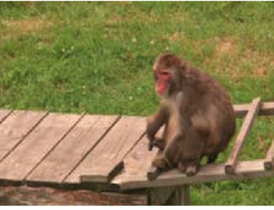

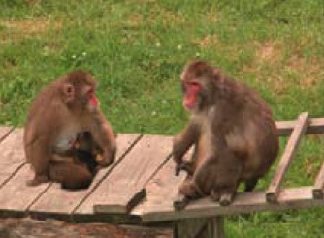
2. Traditional applications of data hiding – Watermarking
Content authentication / Tampering detection / Tampering localization
Fragile or Semi-Fragile Watermarking
Tampering
Authentication or Localization
22

Slide 23
2. Traditional applications of data hiding – Watermarking
Other applications
  Copy control: Never-copy watermarks are embedded in the content. Compliant devices do not allow making a copy of such contents.
  Device control: Some devices can be controlled using embedded watermarks that trigger specific functions or operations.
  Legacy enhancement: New functionalities can be introduced in some technology without interfering with older devices, preserving backward compatibility. The new functionalities are deployed through embedded watermarks.
23

Slide 24

2. Traditional applications of data hiding – Watermarking
Copyright protection: Many watermarking applications focus on copyright protection. Is digital watermarking better than cryptography for copyright?
Plain content
Cipher content
Plain content
Encryption
Decryption
Seller end
Buyer end
Plain content redistribution is possible at the buyer end!!!
24

Slide 25
2. Traditional applications of data hiding – Watermarking
Copyright protection: Many watermarking applications focus on copyright protection. Is digital watermarking better than cryptography for copyright?
Cover content
Watermarked content
© Watermark
Seller end
Buyer end
The buyer obtains marked content only. Redistribution is difficult.
25

Slide 26
2. Traditional applications of data hiding – Steganography
Steganography for dissidents
Some countries have barriers on political freedom and political dissent is not tolerated.
Steganography is a convenient way for political dissidents to conceal their communications without arising suspicions.
Cryptography and anonymous remailers are other alternatives, but they arise more suspicions compared to steganography.
26

Slide 27
2. Traditional applications of data hiding – Steganography
Steganography for criminals
Similarly, criminals and terrorists wishing to establish secret communication can choose between steganography, anonymous remailers and cryptography.
Cryptography can be suspicious, since the communicating parties are not hidden.
Anonymous remailers can be forced to disclose information by authorities.
Steganography is the preferred alternative for secret communications.
27

Slide 28
Properties of Data Hiding Schemes

Slide 29
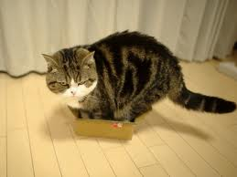
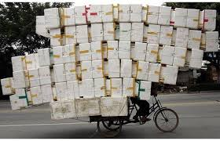
3. Properties of data hiding schemes – Watermarking
Capacity/Payload: Amount of data that can be embedded in an extracted from the marked object. Typically measured in bits per pixel (bbp), bit per second (bps), or bits per frame.
Low capacity
High capacity
29

Slide 30
3. Properties of data hiding schemes – Watermarking
Blind or informed detection or extraction: Do we need the original cover object to extract or detect the watermark?
Watermark
Watermark
Embedder
Extractor (detector)
Non-blind (uses the cover) / Blind (does not use the cover) / Semi-blind (uses the watermark)
30

Slide 31


3. Properties of data hiding schemes – Watermarking
Fidelity / Transparency / Imperceptibility: Refers to the perceptual similarity between the original (unmarked) object and the marked object.
Low transparency
(Perceptible watermarking)
High transparency
(Imperceptible watermarking)
31

Slide 32
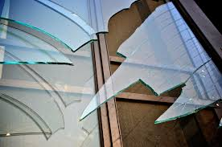
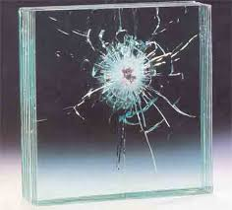
3. Properties of data hiding schemes – Watermarking
Robustness vs Fragility/Semi-fragility: Can the watermark be extracted after signal processing operations (noise addition, cropping, rotation, compression, filtering, and so on)?
Fragile or Semi-fragile watermarking
Robust watermarking
32

Slide 33
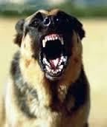

3. Properties of data hiding schemes – Watermarking
Security: Ability of the watermarking algorithm to resist hostile attacks.
High security
Low security
33

Slide 34
3. Properties of data hiding schemes – Watermarking
Security: What’s security in the context of watermarking?
Keys
Embedder
Extractor
Watermark
Watermark
34

Slide 35
3. Properties of data hiding schemes – Watermarking
Security: What’s security in the context of watermarking?
Attacks on the keys
Attacks on the embedding method: Unauthorized embedding and unauthorized removal
Attacks on the extraction/detection method: Unauthorized detection or unauthorized extraction
35

Slide 36
3. Properties of data hiding schemes – Watermarking
Other properties
Embedding effectiveness: Probability of detecting/extracting the embedded watermark (should be close to 100%).
False positive rate: Probability of detecting/extracting the watermark from an unmarked object (should be close to 0).
Modification or multiple watermarks: Some applications require that the watermark may be modified, or multiple watermarks can be embedded in the same content.
Computational time: time required for embedded and detection/extraction. Some applications must work in real time.
36

Slide 37
3. Properties of data hiding schemes – Watermarking
Each application requires different properties
 | Capacity | Blind or Informed | Transparency | Robustness or Fragility | Security
Broadcast monitoring | Low | Blind | High | Robustness against compression, noise and interferences | Yes
Fingerprinting | Low | Either | High | Robust against signal processing | Yes (esp. against collusion)
Content authentication | Low to medium | Blind | High | Fragile or Semi-Fragile | Yes
37

Slide 38
3. Properties of data hiding schemes – Steganography
Capacity: Embedding capacity (amount of data that can be hidden) vs steganographic capacity (amount of data that can be hidden such that an adversary will not detect it!)
Statistical undetectability: The statistics of the stego object shall not differ “much” from the statistics of cover objects such that the communication is not considered to be suspicious.
Security: Passive attacks = statistical undetectability. Active attacks: Introduce distortion in the channel to remove stego messages. Malicious attacks: Delete messages and/or impersonate some parties. Attacks on stego keys are also possible.
38

Slide 39
3. Properties of data hiding schemes – Steganography
Blind or targeted steganalysis: Steganalysis refers to the branch of data hiding aimed at detecting whether some object contains or not data hidden using steganography. Steganalysis can be of three different types:
  System attacks (e.g. a small key space)
  Blind methods: can be applied to any steganographic scheme
  Targeted to a specific method
False alarm rate: Probability that steganalysis detects a hidden message in a not embedded object (should be close to 0).
39

Slide 40
3. Properties of data hiding schemes – Steganography
The following properties are typically not relevant for steganography:
Embedding effectiveness: You can change the cover object if the embedding fails.
Imperceptibility: The perceptual quality of the stego object is not important!!! (unless it may arise suspicions).
Blind or informed extraction: It is assumed that the receiver does not have the cover object to use it for extraction.
Robustness: The stego object is not expected to suffer distortions other than those that are natural to the communication channel.
40

Slide 41
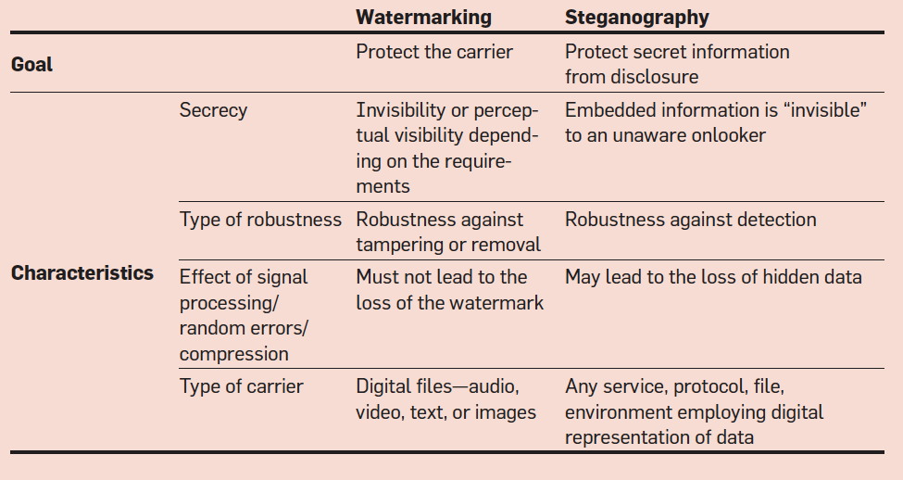
3. Properties of data hiding schemes – Comparison
Watermarking vs
Steganography
41

Slide 42
3. Properties of data hiding schemes – Trade-off
Digital watermarking
Capacity
Steganography
Statistical
undetectability
Capacity
Imperceptibility
Robustness
42

Slide 43
Emergin Data Hiding Applications (for Good and Evil)

Slide 44
4. Emerging Applications – Watermarking
Privacy-preserving transaction tracking (fingerprinting)
Buyer-Seller
Protocol
© Leonardo
Digital Content
44

Slide 45
4. Emerging Applications – Watermarking
Privacy-preserving transaction tracking (fingerprinting)
If the merchant embeds the fingerprint, he/she can frame an innocent user of illegal redistribution:
  Asymmetric fingerprinting: The fingerprinted content is made available only to the buyer!
  Anonymous fingerprinting: The identity of the buyer is protected through anonymous communication.
Anonymity is preserved if no illegal redistribution occurs.
Properties: Piracy tracing, asymmetry, anonymity, collusion resistance, dispute resolution, non-repudiation, unlinkability.
45

Slide 46
4. Emerging Applications – Watermarking
Privacy-preserving transaction tracking (fingerprinting)
Non-centralized distribution solutions: P2P and broadcasting applications.
Combined with DRM (key management).
Combined with smart contracts and cryptocurrencies for integrated payments.
46

Slide 47
4. Emerging Applications – Watermarking
Privacy-preserving transaction tracking (fingerprinting)
Collusion attack!
Buyer #1: 101101100011010100100011110011
Buyer #2: 010101010111010101010110101001
Buyer #3: 110101010101010010101010001010
========================================
Colluded: xxx101xx0xx1010xxxxxxx1xxxx0xx
Collusion-resistant codes make it possible to trace at least one of the colluders!
47

Slide 48
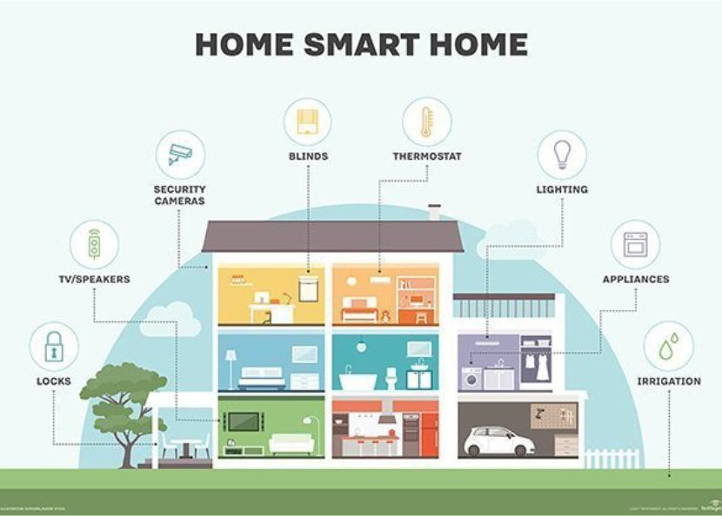
4. Emerging Applications – Watermarking
Digital watermarking for data provenance (IoT security)
Many lightweight devices are being connected to the Internet:
Low computation capacity
Lightweight cryptography
Vulnerable to different attacks
Intrusion detection systems (IDS) and intrusion prevention systems (IPS) are required.
48

Slide 49
4. Emerging Applications – Watermarking
Digital watermarking for data provenance (IoT security)
Zero-watermarking can be used to track the path of network packets (data provenance).
Zero-watermarking is efficient. Lightweight devices can deploy it even with their limited computing capacity.
No actual data embedding. Side information can be stored at a local database or a blockchain.
More information available (not only source/destination of the network packets).
IDS/IPS can work with more information in real time and detect attacks as they are being deployed, making it possible to take the appropriate action.
49

Slide 50
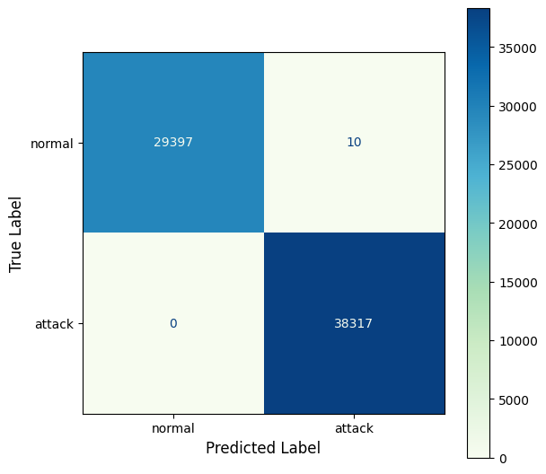
4. Emerging Applications – Watermarking
Digital watermarking for data provenance (IoT security)
50

Slide 51

4. Emerging Applications – Watermarking
Digital watermarking for forensics
Surveillance cameras and other devices can record scenes that may be relevant for criminal investigations.
Authentication marks may be embedded by hardware.
Authenticated videos/pictures may be used directly in court (without expert validation).
Detection of forgeries may be possible even at pixel level.
51

Slide 52



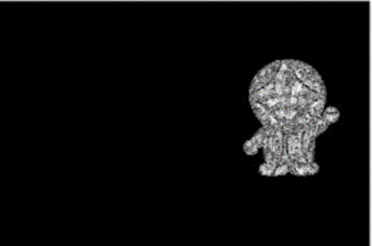
4. Emerging Applications – Watermarking
Digital watermarking for forensics
Watermarked video
Forged video
Extracted watermark
Forgery localized
52

Slide 53
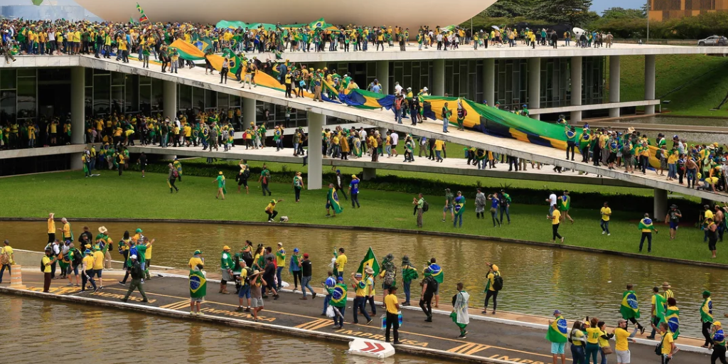
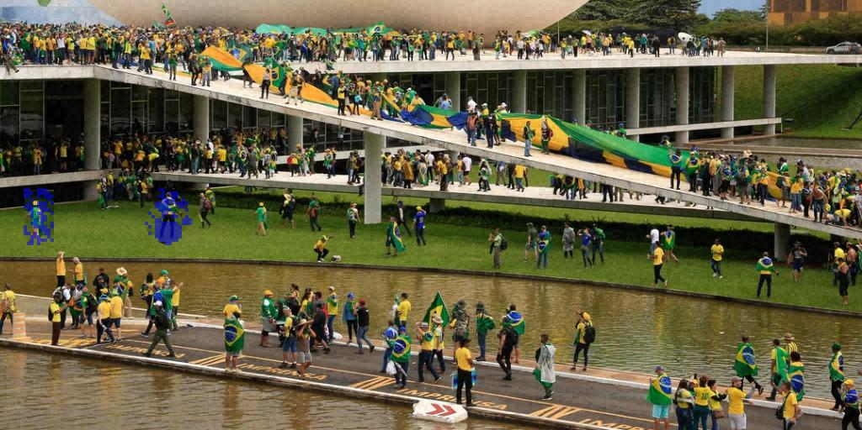

53
DISSIMILAR – Fake news detection
Original image
Tampered image
DISSIMILARities
Found!
Tamper detection
Tamper mask

Slide 54
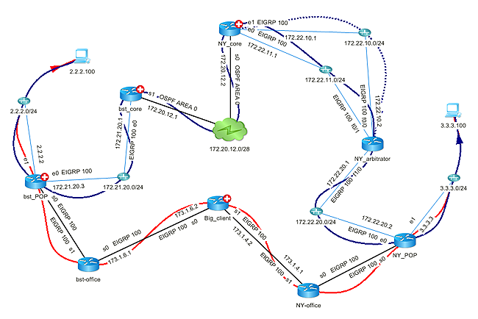
4. Emerging Applications – Watermarking
Network flow watermarking
Data can be hidden in the network traffic by altering the timing, the size or the rate of the packets.
The embedded watermark can be extracted at another location on the Internet.
Legitimate purposes: Tracing network attacks, locating the master of a botnet or diagnosing some networking problems.
Illegitimate purposes: security and privacy attacks, tracing VoIP calls, co-residence attacks in cloud environments, compromising some platforms.
54

Slide 55
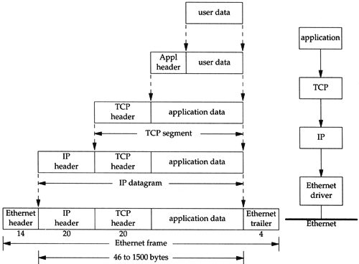
4. Emerging Applications – Steganography
Network steganography
The network protocols provide different opportunities for steganography.
Steganographic methods have been proposed at almost any network layer from the application to the physical layer.
Schemes are based on the modification of the PDU (packets), either the in header or in the payload, the modification of the time relation between PDUs (similarly to network flow watermarking) or hybrid.
55

Slide 56
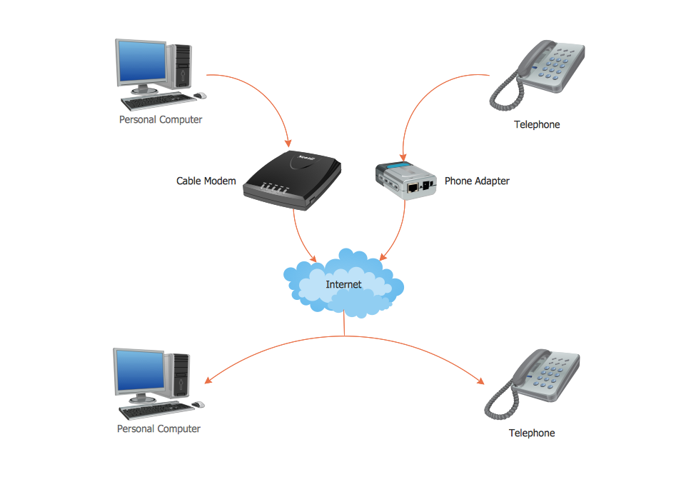
4. Emerging Applications – Steganography
Voice over IP (VoIP) steganography
Most voice calls are now carried out over the Internet Protocol (VoIP).
VoIP steganography makes it possible to create a covert channel over a voice call.
Speech compression is very efficient (from 64/128 kbps to 2-6 kbps).
The covert channel allows even sending a secret voice message hidden in an “innocent” VoIP call.
This is an extreme example of current trends in steganography.
56

Slide 57

4. Emerging Applications – Steganography
Steganography for criminals and terrorists – A serious threat!
Illegal images (e.g. child pornography or stolen photos of celebrities) can be exchanged by criminals using steganography.
Valuable documents can be stolen and transmitted covertly (espionage, intellectual property theft or industrial secrets theft).
Secret communications between criminals and terrorists through steganography has been discovered.
Standard IDS/IPS, firewalls and content filter tools are evaded!!!
57

Slide 58

4. Emerging Applications – Steganography
Steganography for malware injection (Stegomalware)
Malware can be hidden using steganography, making it possible to distribute it covertly: e.g. using digital media as the secret carrier, creating a covert channel over network traffic, hiding control commands in HTML tags, hiding JavaScript code by modifying the color space of PNG images…
Different malware like ransomware, trojans or worms can be distributed in this way.
It is also possible to run exploits or steal users’ data.
58

Slide 59
Summary

Slide 60
5. Summary
Data hiding encompasses a collection techniques, including digital watermarking and steganography, that make it possible to embed secret information into different carriers.
An overview of traditional data hiding applications has been provided.
The properties required for watermarking and steganography have been introduced.
The current trends and some emerging applications, both for good and evil, have been briefly outlined.
Raise awareness about data hiding and its emerging application areas and threats to technical and non-technical audiences.
60

Slide 61

Thank you!!!
Véronique Debord-Lazaro

